Slide 1
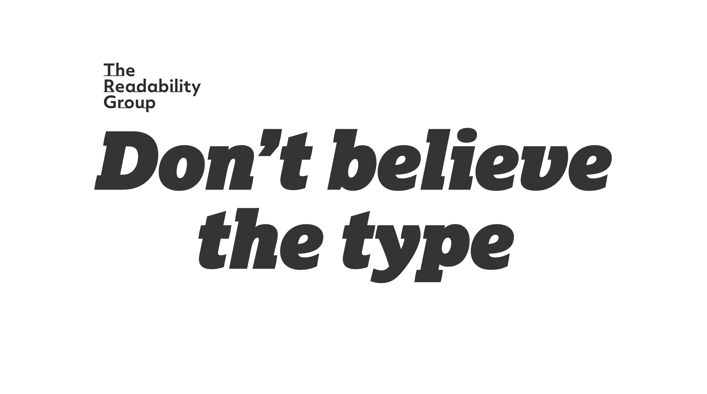
Notes:
DB:
Firstly, a heads-up to anyone who is visually impaired. Ours is a very visual subject matter
But the slides we’re showing merely echo what’s being said or described. So rest assured you’re getting the essential information.

Slide 2
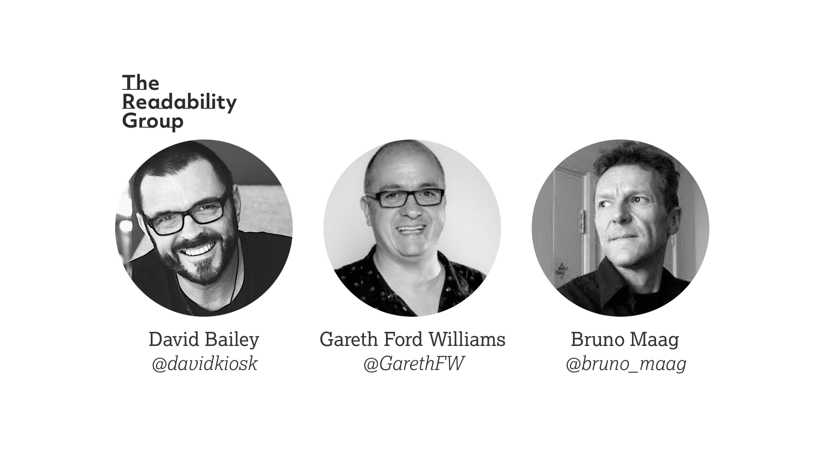
Notes:
DB:
So allow me to introduce us… you have
Myself David Bailey, a design director
Gareth Ford Williams, an accessibility specialist
and Bruno Maag, a typeface designer.
Needless to say between us we’ve many years of experience and recognition under our belts.
We met a few years ago through our day jobs, whilst developing the BBC Reith typeface. Once we completed that project we realised there so many unknowns about how the human brain consumes and processes typefaces and the written word. So along with our friend Michael, we started a research initiative we’ve called The Readability Group.

Slide 3
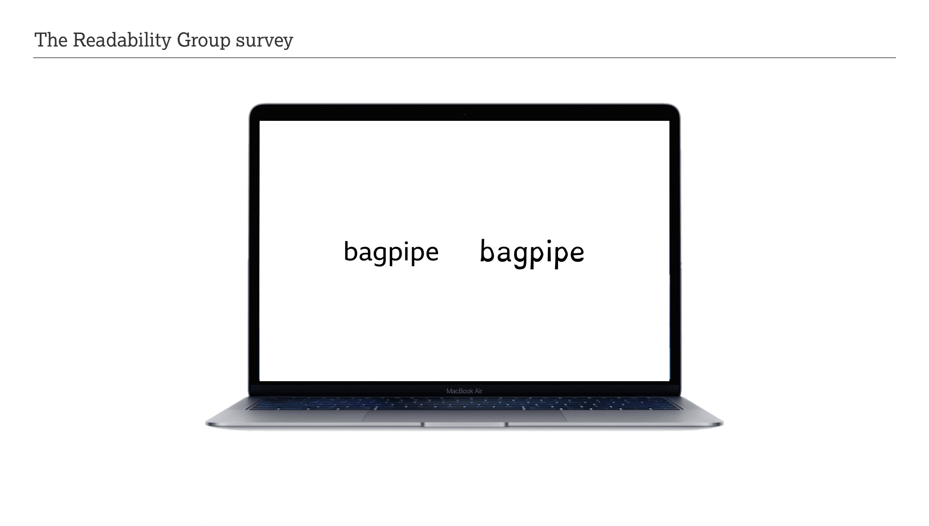
Notes:
DB:
We’re here to talk about our research — What it is > Why it’s important > And why you should care.
As a group we are interested in how human beings read, and how to optimise that process by surfacing data that TIL NOW has been notable by its absence.
Absence of this data is causing otherwise rigorous practitioners to fallback on hearsay and anecdote.
And as our friend Jamie once said; ‘the plural of anecdote is not data’
So we’re looking to fill in the gaps.

Slide 4
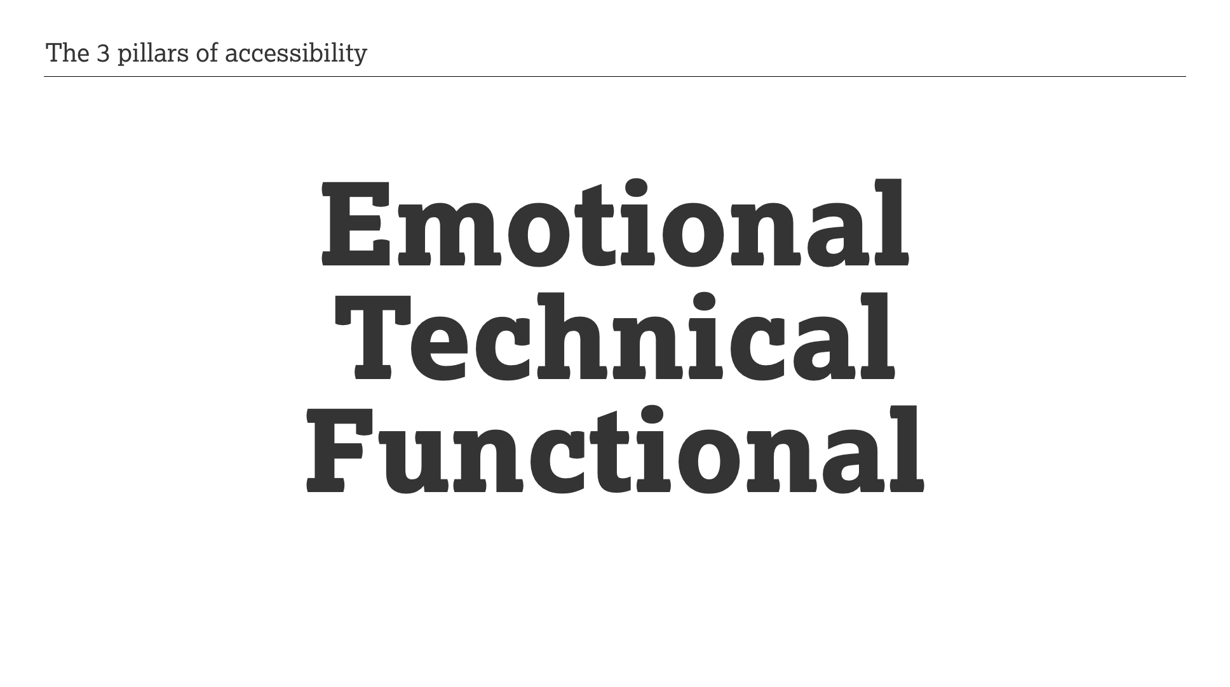
Notes:
DB:
But I’m going to start with the foundations that underpin our work.
We call then the 3 pillars of accessibility:
Emotional, Technical and Functional

Slide 5
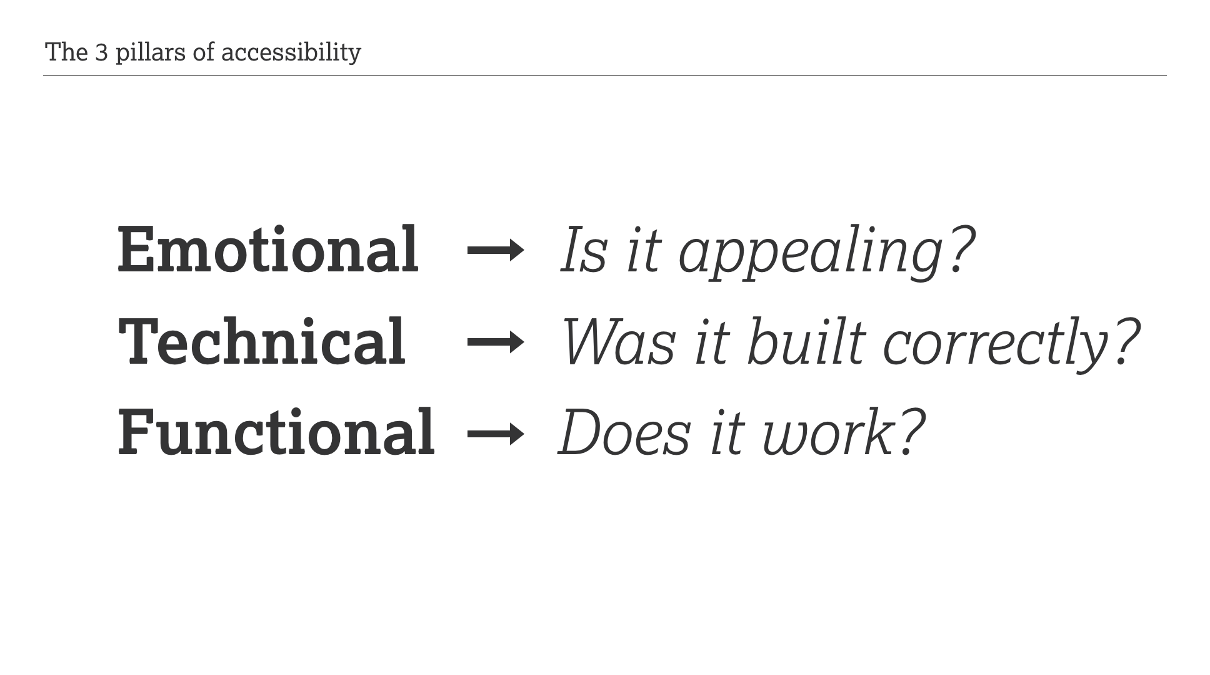
Notes:
DB:
So…
Emotional – is it appealing?
Technical – was it built correctly?
Functional – does it work?
Our research focusses primarily on emotional and functional a11y.
But all three are essential components of making something accessible.

Slide 6
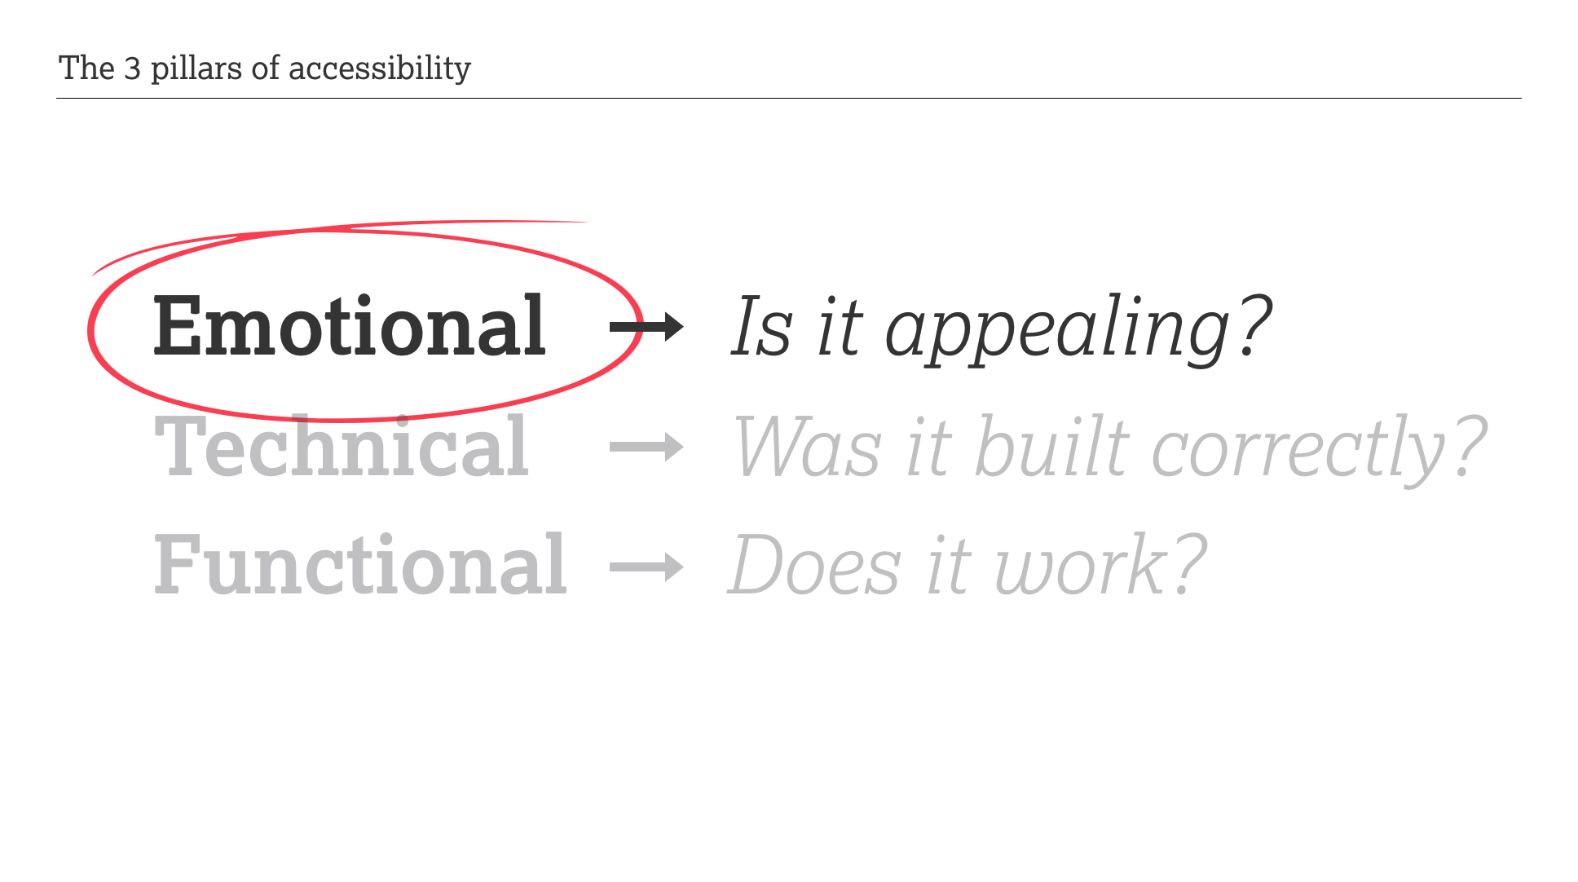
Notes:
DB:
• I’m going to briefly talk about emotional accessibility, and why it’s such an important piece of the puzzle.
• Emotional a11y is rarely talked about. It’s often remove emotion in favour of data.
• But emotional accessibility should come first!
• Why? Because if something lacks appeal in the first place, it’s already failing.
• Making something technically and functionally sound, is meaningless if no one wants it.

Slide 7
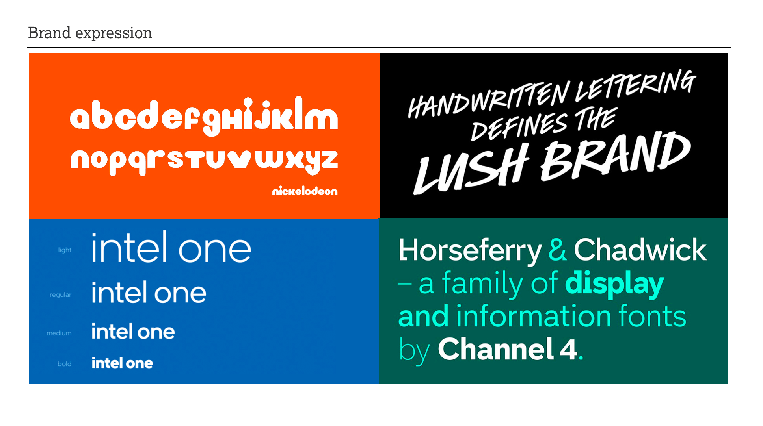
Notes:
DB:
• This is where brand comes in, and why choosing the right typeface is crucial.
• For most users it’s their first impression of your product… (and we know how important that is).
• Your typeface is your visual TOV — from a logo or a slogan, to more complex messaging or instructions.
• So your typeface and your typography aren’t MERELY branding concerns… They are central to your brand.
• AND YOUR BRAND IS YOUR REPUTATION.
• When it comes to brand, fashion obviously has a role to play…

Slide 8
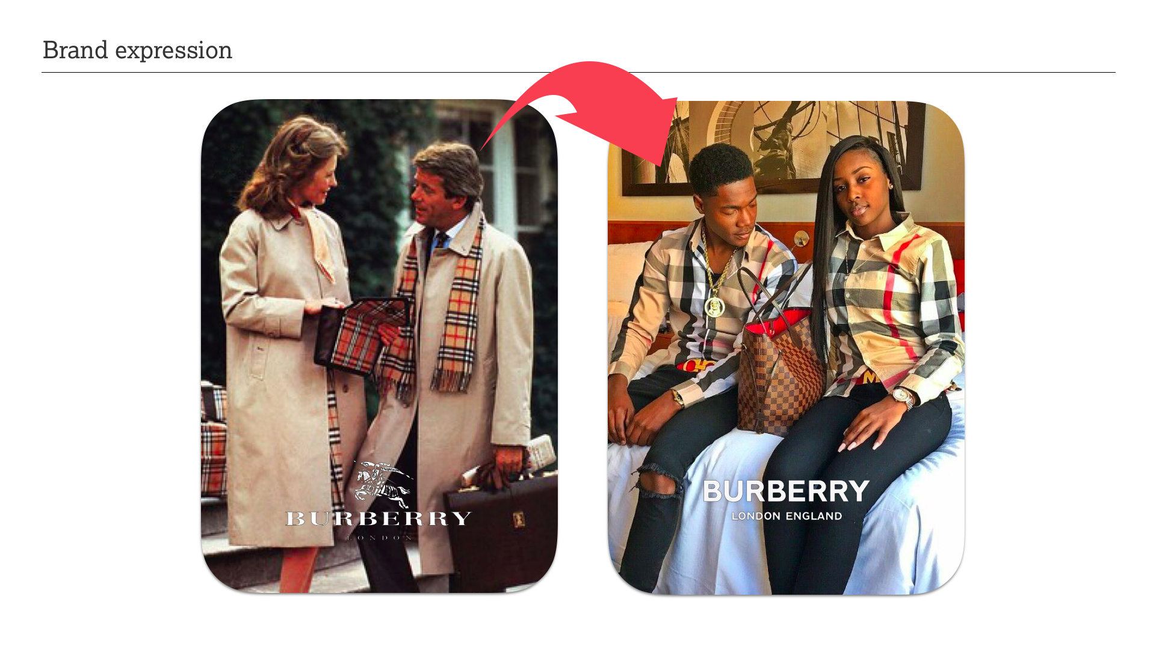
Notes:
DB:
Let’s use an ACTUAL fashion brand — Burberry — to help explain why.
In recent years Burberry have been repositioning their brand;
from HIGH SOCIETY affluence,
to HIGH-END street culture.

Slide 9
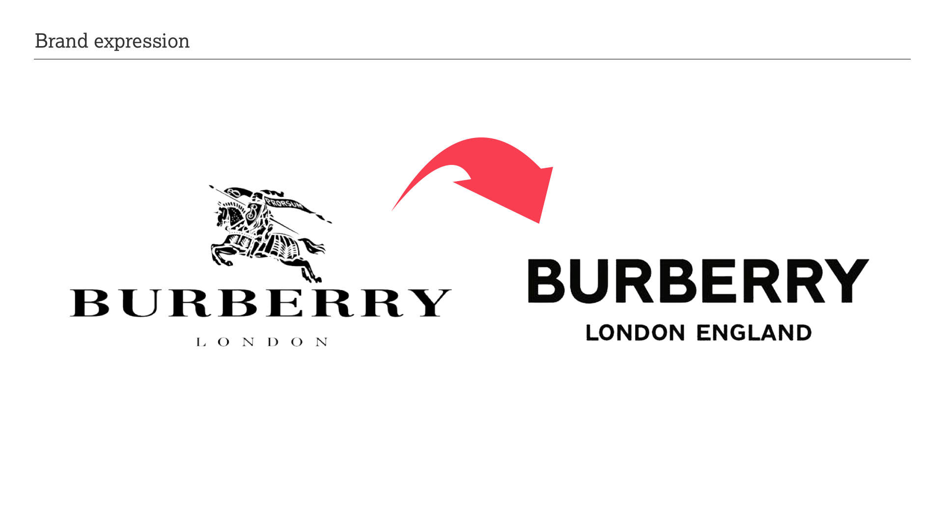
Notes:
DB:
• In the process they redesigned their logo.
• They replaced its elegant detail with neutral typography.
• This caused heated debate among the design knitting circle.
• The big question being: “ARE LOGOS STILL EVEN RELEVANT?"
— If they’re not then “WHERE’S THE HARM IN CHANGING IT?” I hear you ask.
— But conversely; if a logo isn’t important then “WHY BOTHER CHANGING IT?”
• Might this redesign have reduced Burberry’s appeal? Maybe. Maybe not. Beauty is in the eye of the beholder.
• But it suggests that pure functionality is now in fashion.
One thing is for certain; being functional isn’t the end all and be all.
But then neither is aesthetic.

Slide 10
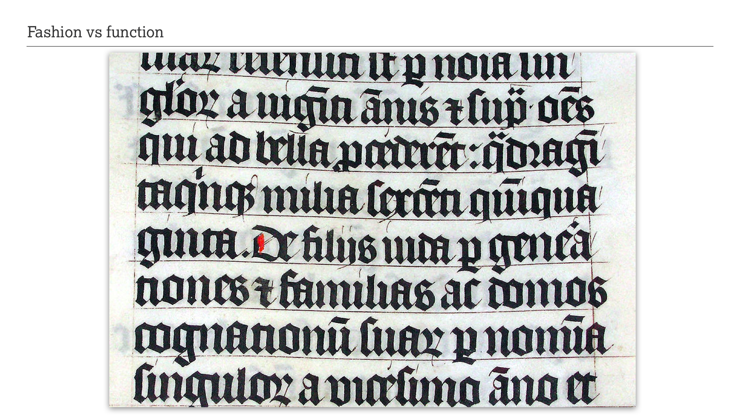
Notes:
DB:
“TYPE FASHION” began in Western Europe in the mid thirteenth century with the emergence of gothic manuscript lettering which later evolved into so-called ‘blackletter’ typefaces.
This elaborate style would later be appropriated by the Nazis in the 1930s. It helped define their brand through visually aggressive propaganda. And sadly, for many years after, blackletter would be associated with this dark chapter in our history.

Slide 11
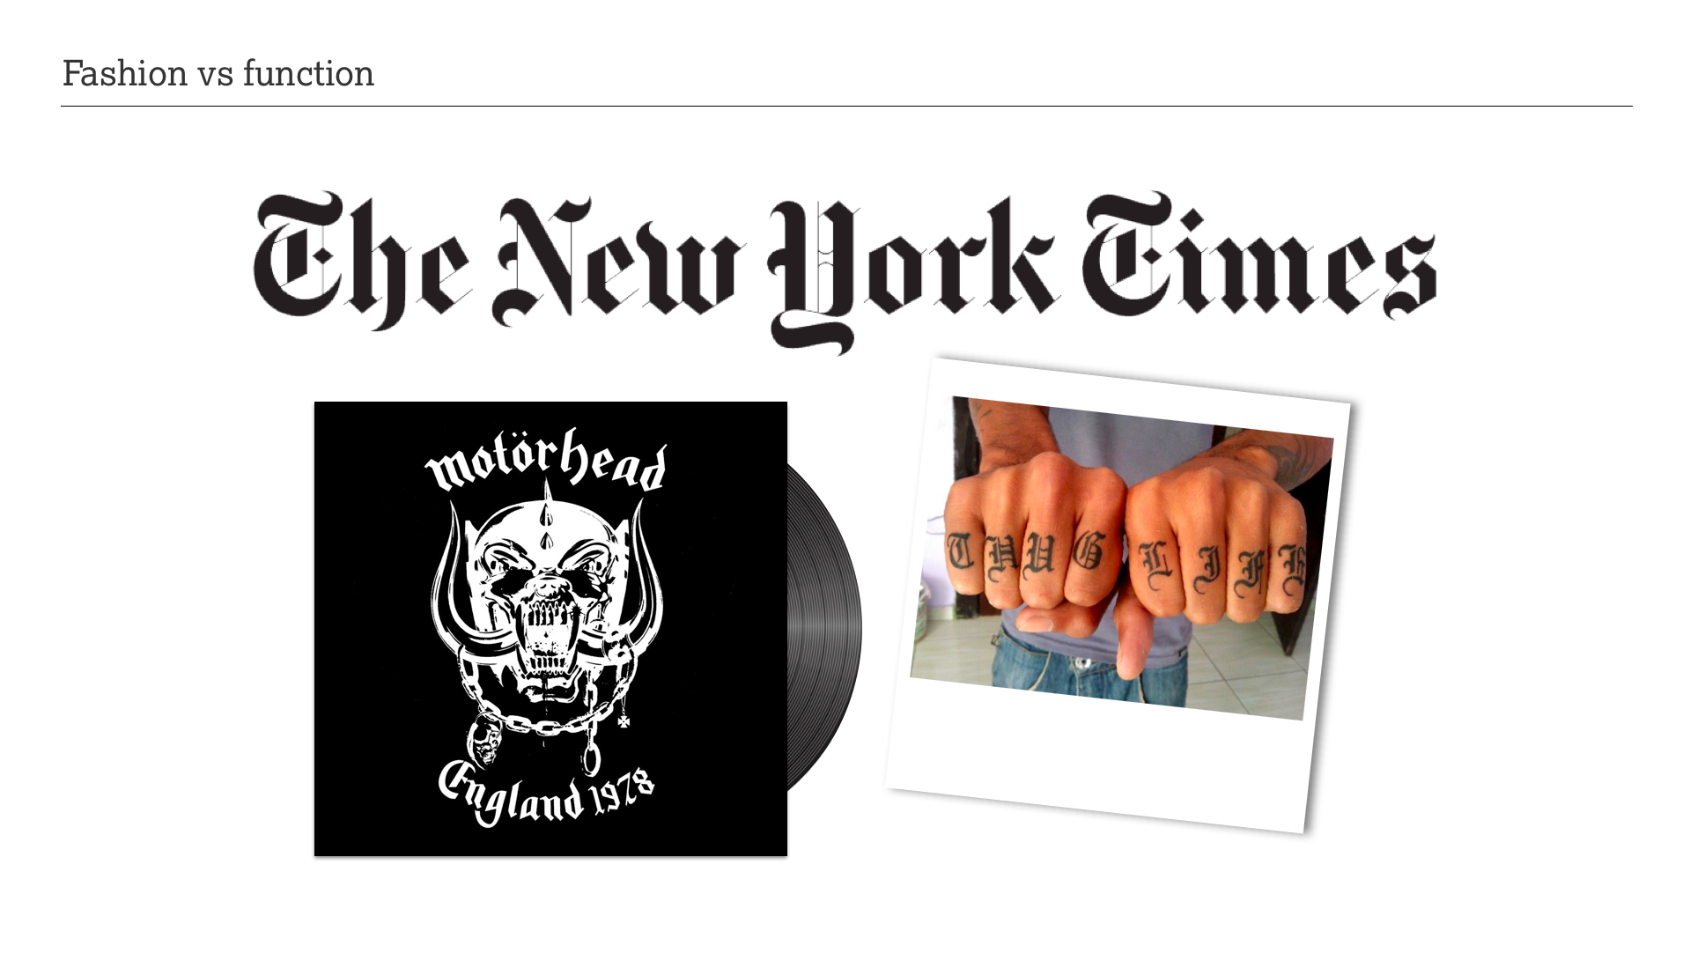
Notes:
DB:
• But time is a healer, and the blackletter style would slowly be reclaimed through media and popular culture.
• Its use on newspaper mastheads conveys an authoritative and learned personality.
• In the 70s and 80s it was adopted by heavy metal bands to convey the drama and complexity of their music.
• And in the 90s, blackletter became ubiquitous in urban street wear.
• It remains a cool “bad boy” fashion choice.

Slide 12
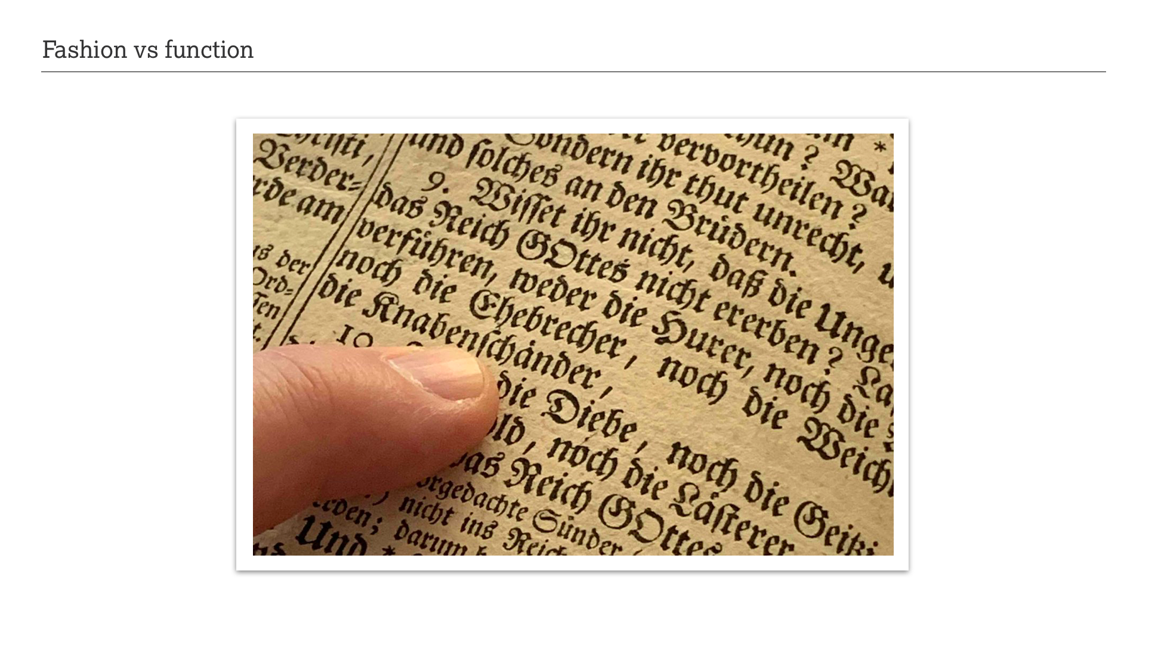
Notes:
DB:
• So emotionally, we see that a style as complex as blackletter can be very effective.
• But functionally, it struggles.
• Its unusual shapes make it hard to read.
• …but that’s because we’re not used to reading those shapes.
• They’re unfamiliar, causing our brain to make mistakes.

Slide 13
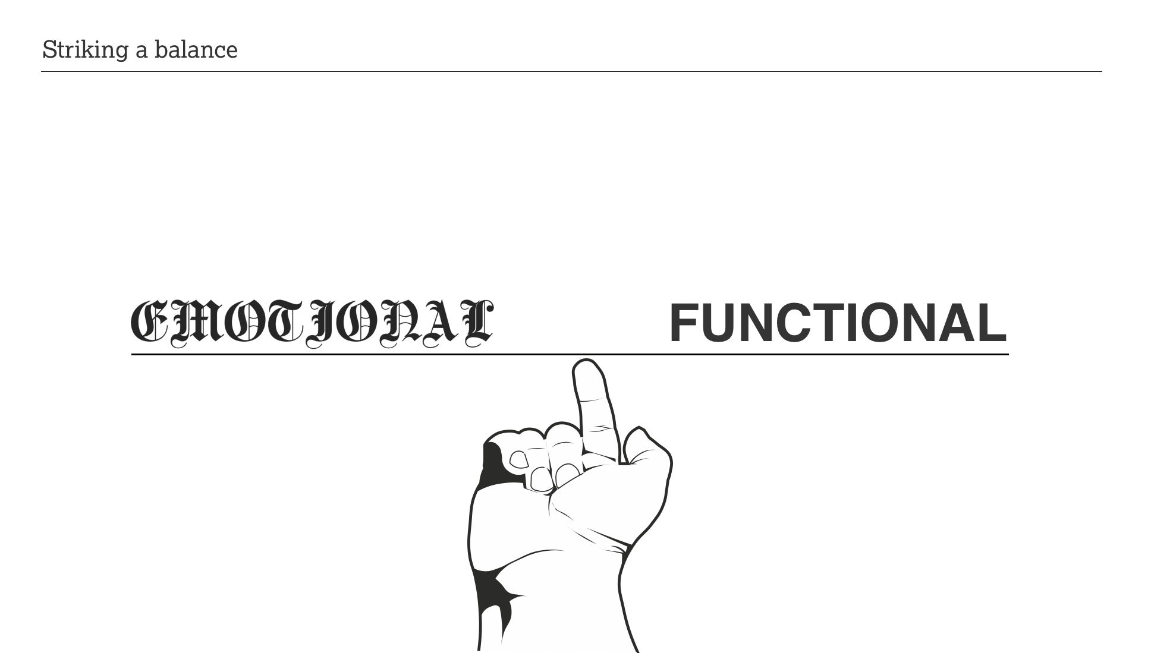
Notes:
DB:
We know that accessibility can’t be perfect.
It can only be optimal.
So to optimise a reading experience one must balance the emotional with the functional.

Slide 14
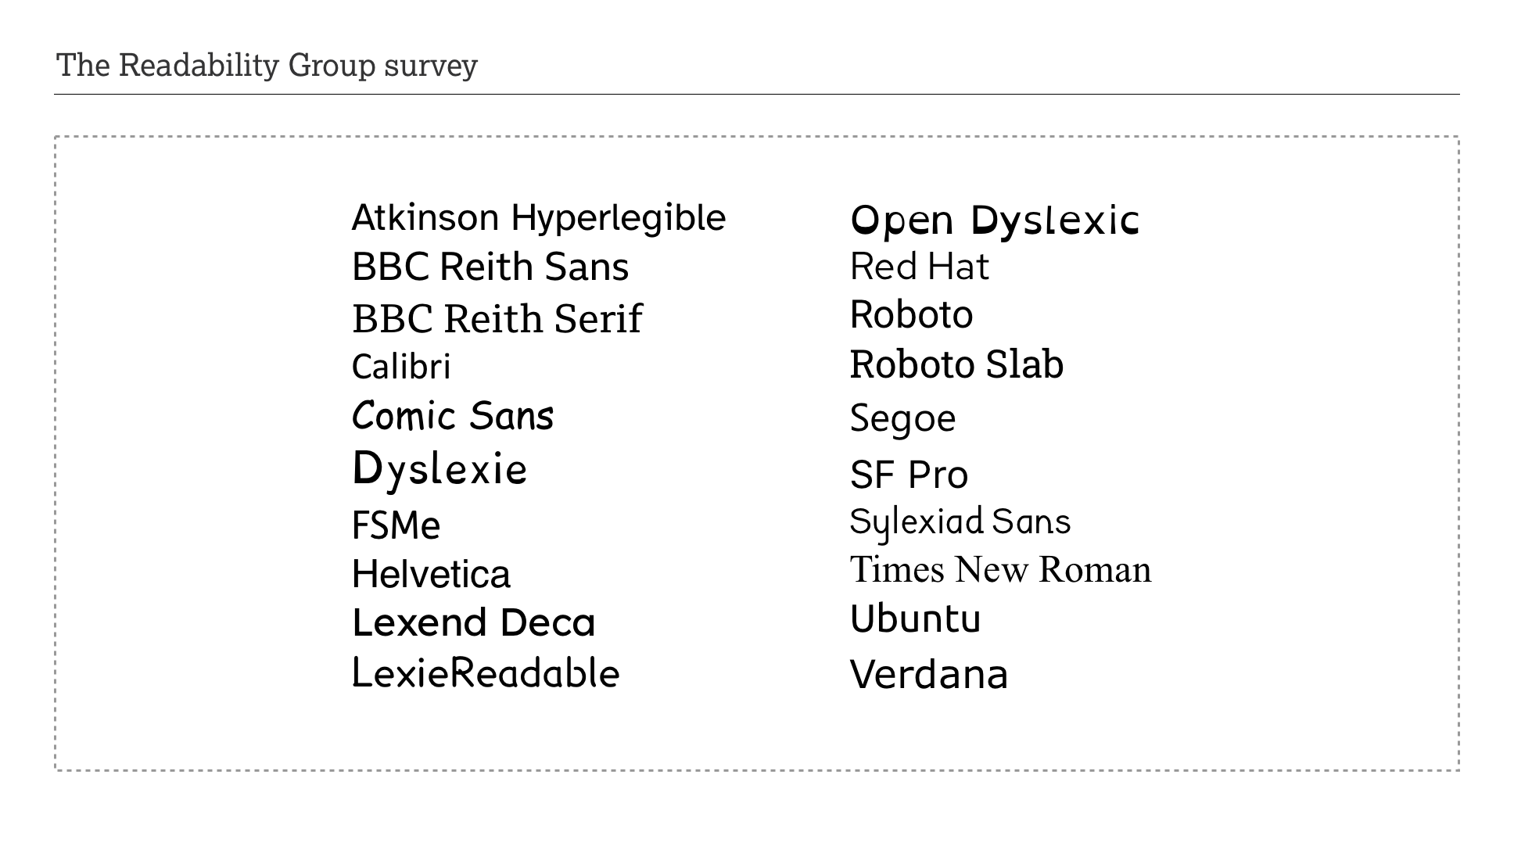
Notes:
GFW:
On the 9th of February we launched our first study into font accessibility. We asked people to “take no more than a couple of seconds to choose which version of the word you find the easiest to read”, and if possible to remove their reading glasses to make the decision more challenging.
We did this because of a lack of quantitative data on the subject and also because we wanted to test out an evaluation methodology.
The study is not about finding the most accessible font, but about understanding more about the emotional and functional barriers experienced by specific user groups. As such we limited the study to 20 fonts and looked to capture the richest data we could. There is no hypothesis to prove here so we designed the study to capture the richest dataset possible. BTW we are still collecting data so this is just a first report.

Slide 15
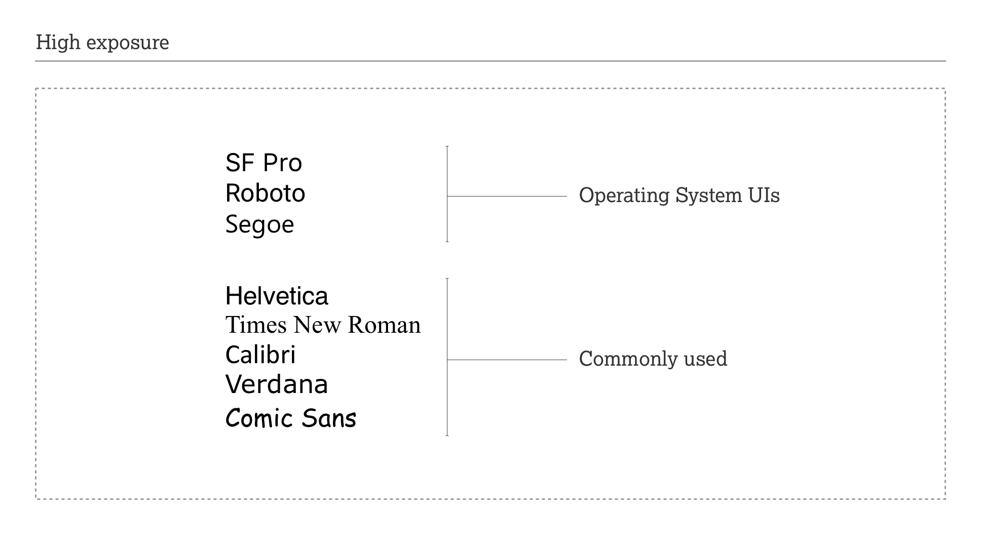
Notes:
GFW:
Before we start looking at some of the numbers we should talk about bias.
Confirmation Bias is a big problem in many of the studies we have looked at, with studies trying to validate a hypothesis rather than inform it. There are other outside factors, some you can’t control. One is how used to typefaces we are. There is lots of evidence already that suggests the more we are exposed to a typeface the easier we find it to read. So fonts that are in our operating systems or fonts we have grown up with will benefit from some degree of unconscious bias.

Slide 16
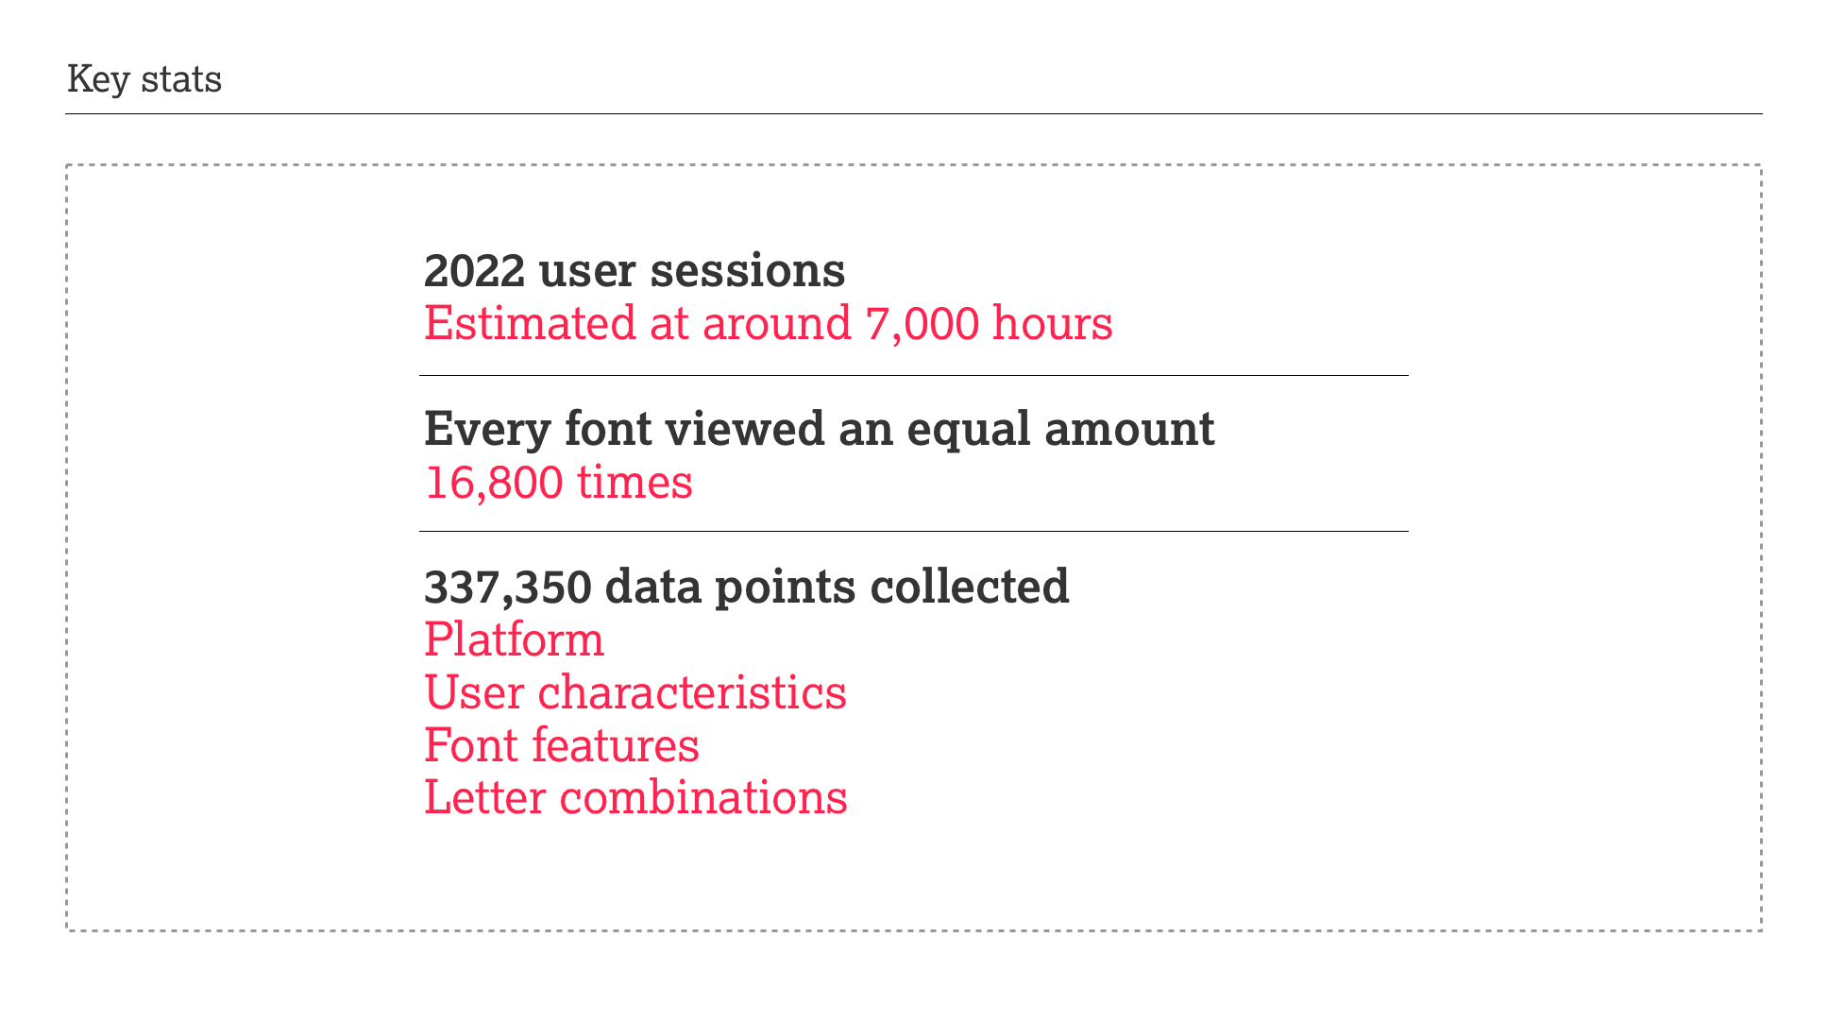
Notes:
GFW:
Here are a few numbers to get us started
At the point when we grabbed the data for this presentation:
2022 people had participated, which is more than 7,000 hours volunteered… thank you
Each font had been viewed around 16,800 times
We had collected 337,350 data points
We were also collecting data on the platforms, devices and browsers: Mac OS 35%, Windows 28%, iOS 19%, Android 18% and Linux 2%
We have rich enough data to create over 8,000 user segmentations … more on this in a moment
We also flagging specific letter combinations that could cause potential legibility issues

Slide 17
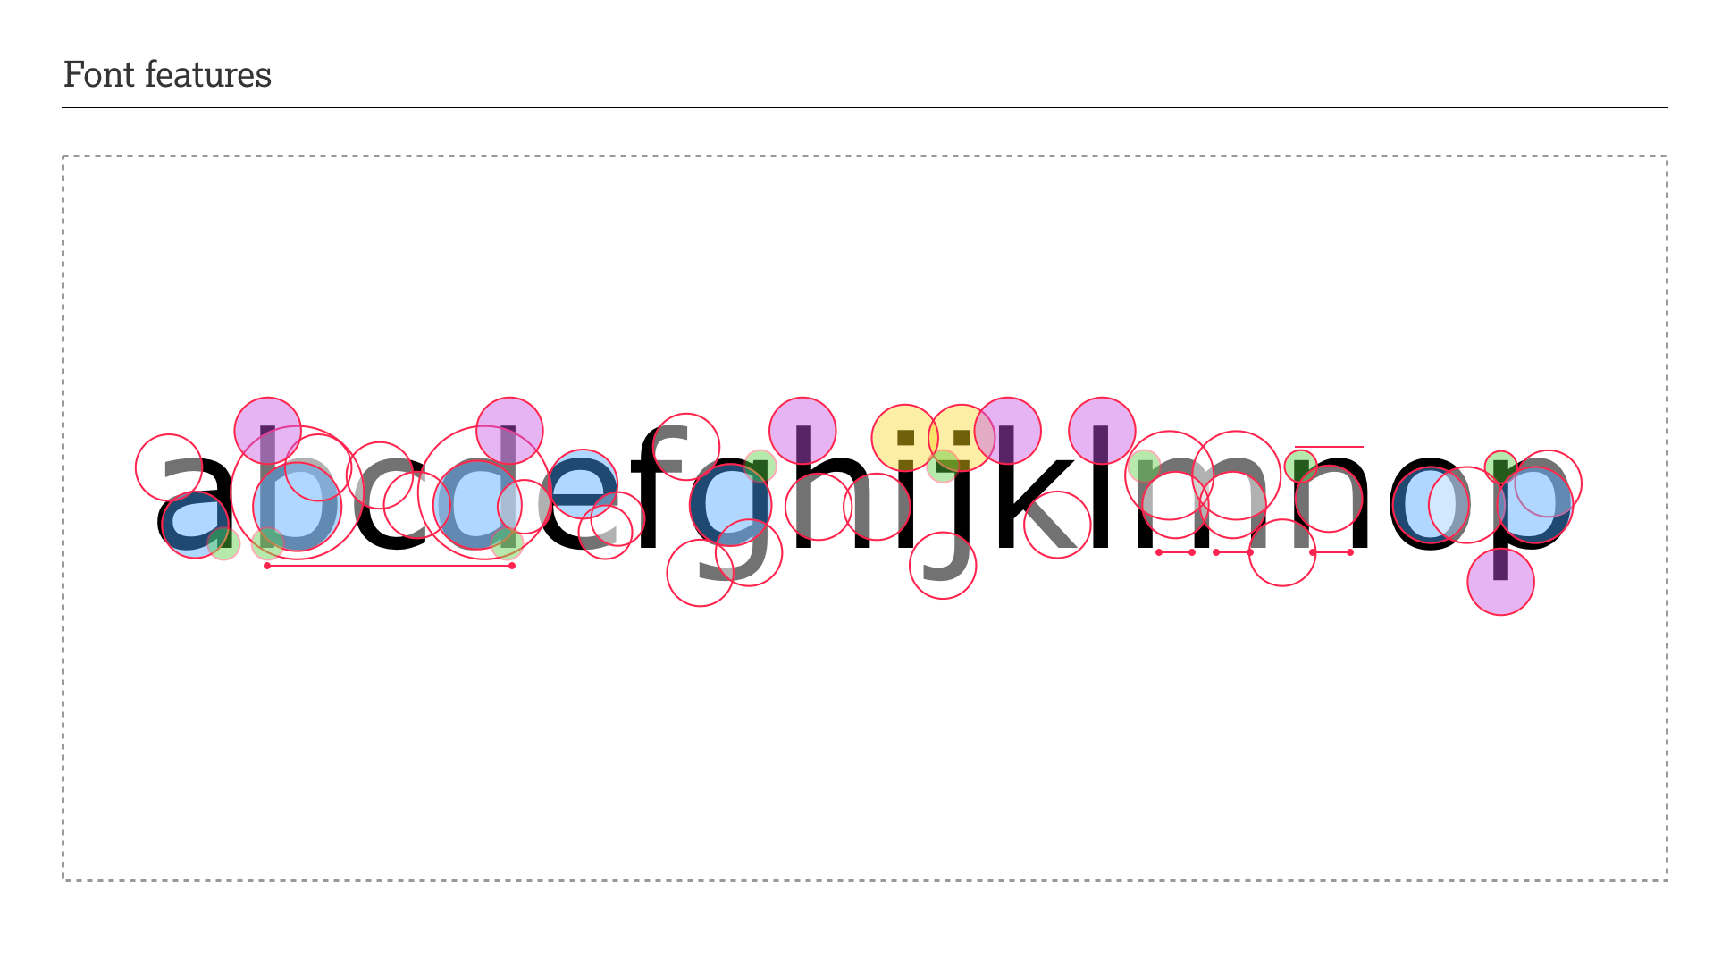
Notes:
GFW:
On the point about the font we have to be mindful that fonts are complex. It’s not about Serif vs Sans as there are many features and characteristics, which each have a multitude of variables and combinations. In this study we are able to track 23 separate font features with over 73 variable so we can see if we can identify any issues. This is purely functional data and is one of the first things we want to prove the methodology is capable of providing meaningful data.

Slide 18
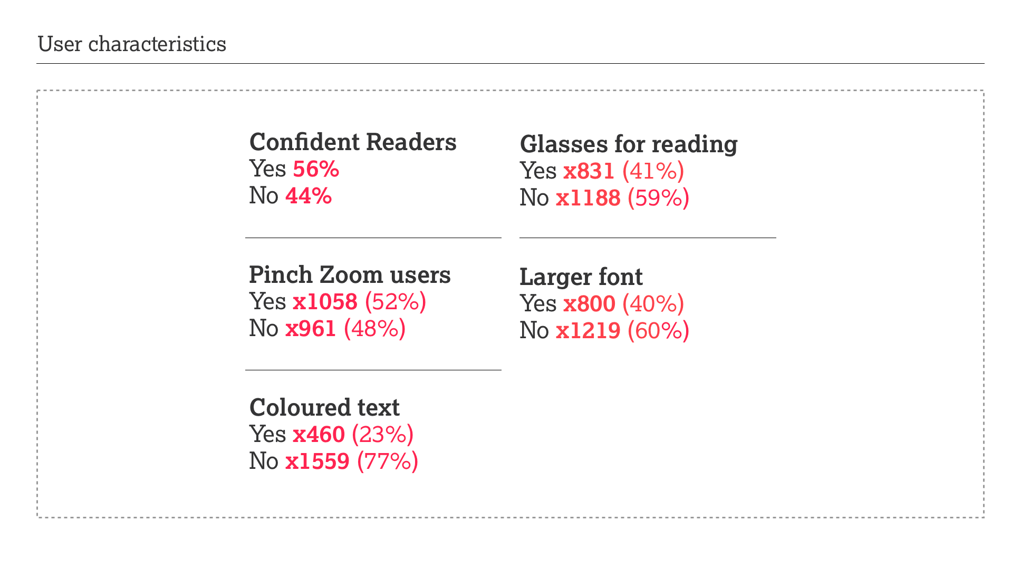
Notes:
GFW:
One of the first thing we needed to do is to be able to segment the survey participants into meaningful groups. Instead of looking for demographic identifiers we instead destined the survey to be algorithmic, so for each participant we can understand something about the barriers they face.
So every participant’s data becomes attributed to one of over 8,000 barrier personas. Some are really obvious and others care based on combinations of answers
56% were “confident readers” but that could also include people with conditions who were skilled readers, were confident with their assistive technology or had great coping strategies.
52% used pinch zoom
23% preferred coloured text
41% wore glasses for reading
40% prefer larger fonts

Slide 19
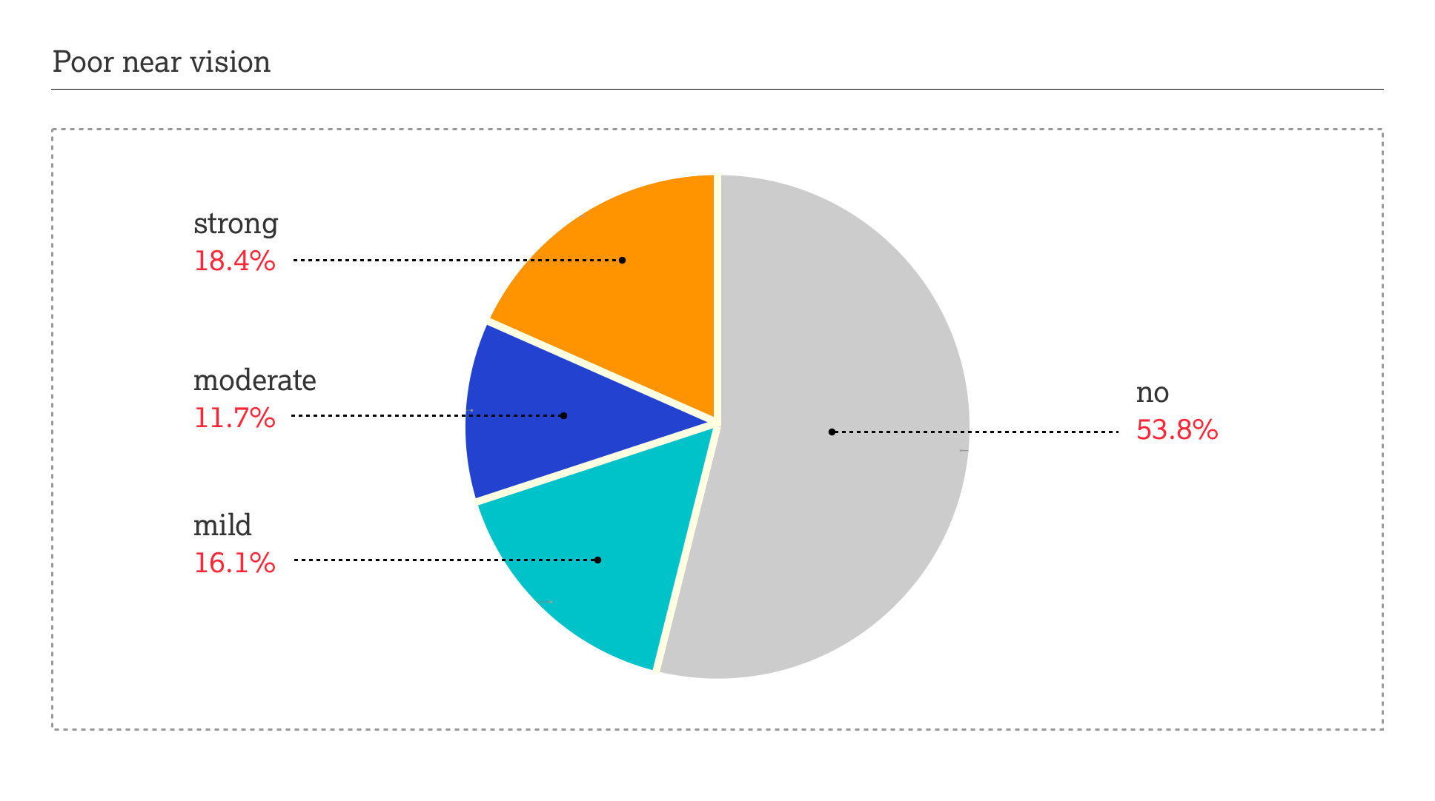
Notes:
GFW:
But we can also create complex user groups with weightings:
A subset of people with vision impairment are people with poor near vision;
The algorithm enabled us to identify 3 groups with related barriers:
16.1% have mild impairment
11.7% moderate
18.4% have a significant vision impairment

Slide 20
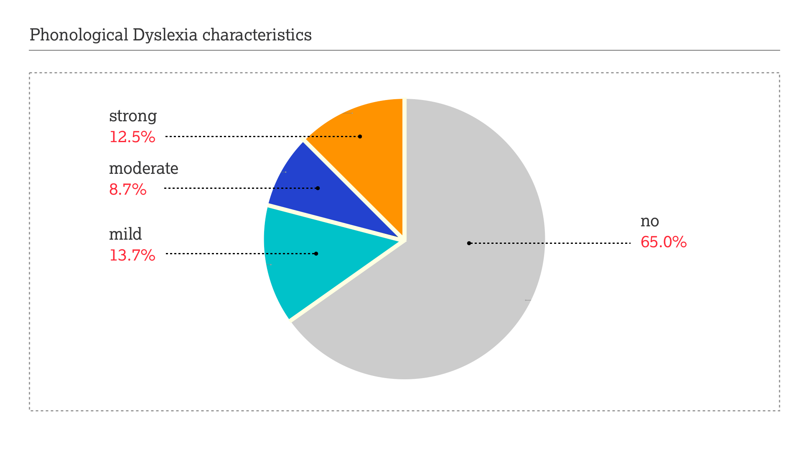
Notes:
GFW:
And the other group we will take a quick look at are those with dyslexic characteristics. As most people with dyslexia are undiagnosed, especially people like me who left school before 1989, it is important we focus on the characteristics rather than relying on original or self-diagnosis. Also there is a significant variety of traits that aren’t dyslexia that some people with dyslexia experience. These we can also identify as sub-groups.
13.7% mild
8.7% moderate
12.5% have strong characteristics of the conditions.
The great thing as these stats align closely with the numbers often forecasted by representative groups and healthcare organisations.

Slide 21
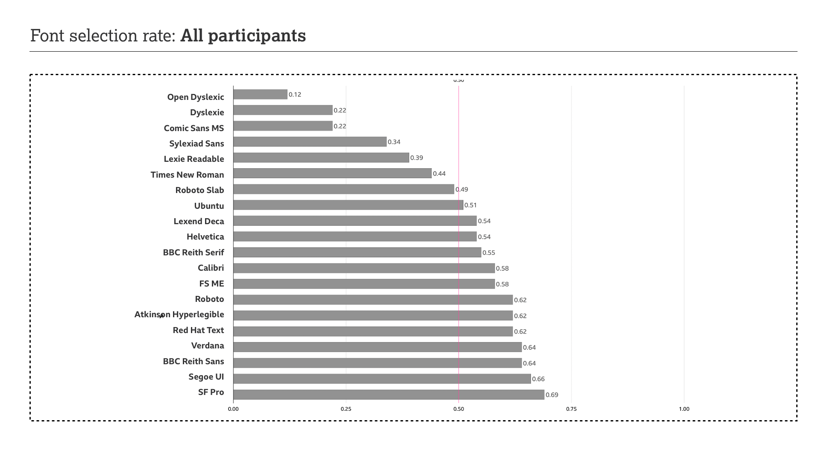
Notes:
GFW:
Let’s start with the high level figures and this chart is the frequency by which the fonts were selected by all participants.
At first glance have 4 groups.
Those who have not performed well: Open Dyslexic with 12%, with Dyslexie, Comic Sans, Sylexiad Sans, Lexie Readable and Times NR ranging from 22% to 44%
Those who were fairly neutral around 50%; Roboto slab, Ubuntu, Lexend Deca, Helvetica and performing overall slightly better than Helvetica, BBC Reith Serif
Those who did quite well, Calibri, FS Me, Roboto, Atkinson Hyper Legible and Red Hat Text
At the top of this chart we we have Verdana, BBC Reith Sans, Segoe and San Francisco Pro
None of the fonts scored over 70%... which is an interesting stat in itself.
Remember what I said at the start that we expected some bias towards what we see everyday.
Also if this is a beauty contest, which has crossed our minds, then when we dig into the numbers this won’t change.

Slide 22
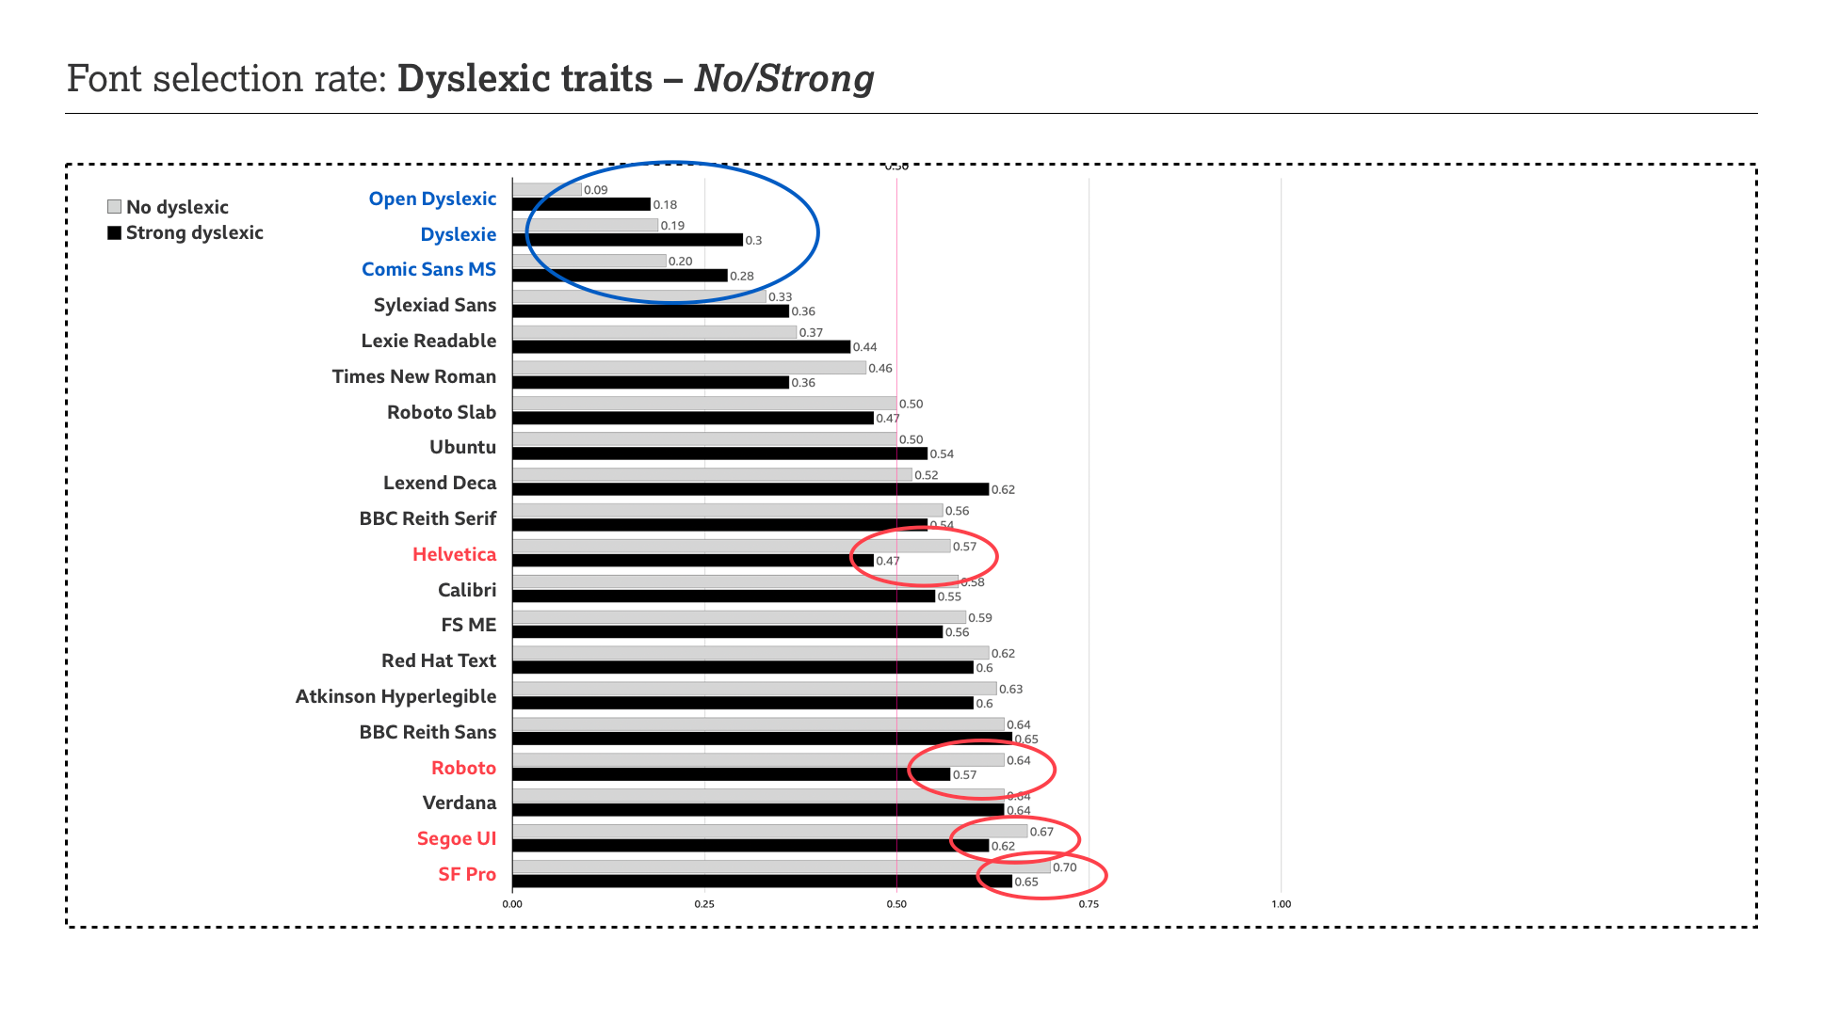
Notes:
GFW:
But when we start segmenting the data interesting things come to light
We expected that the Strong Dyslexic Characteristics group would change a bit. There is an uplift.
Even with the uplift and keeping in mind this is the Strong Dyslexia Group, Open Dyslexic 18%, Dyslexie, 30%, Comic Sans 28%... so is this to do with associated traits for some dyslexic people rather than the condition itself? The majority of the severely dyslexic participants still reject them but for the rest what is going right?
Is it functional, cultural or placebo? You might have dig deeper and cross reference with available qualitative data to unpack this.
The most interesting things are the gaps. All three mainstream UI fonts drop by 5 to 7% but Helvetica and Times nosedive by 10%.

Slide 23
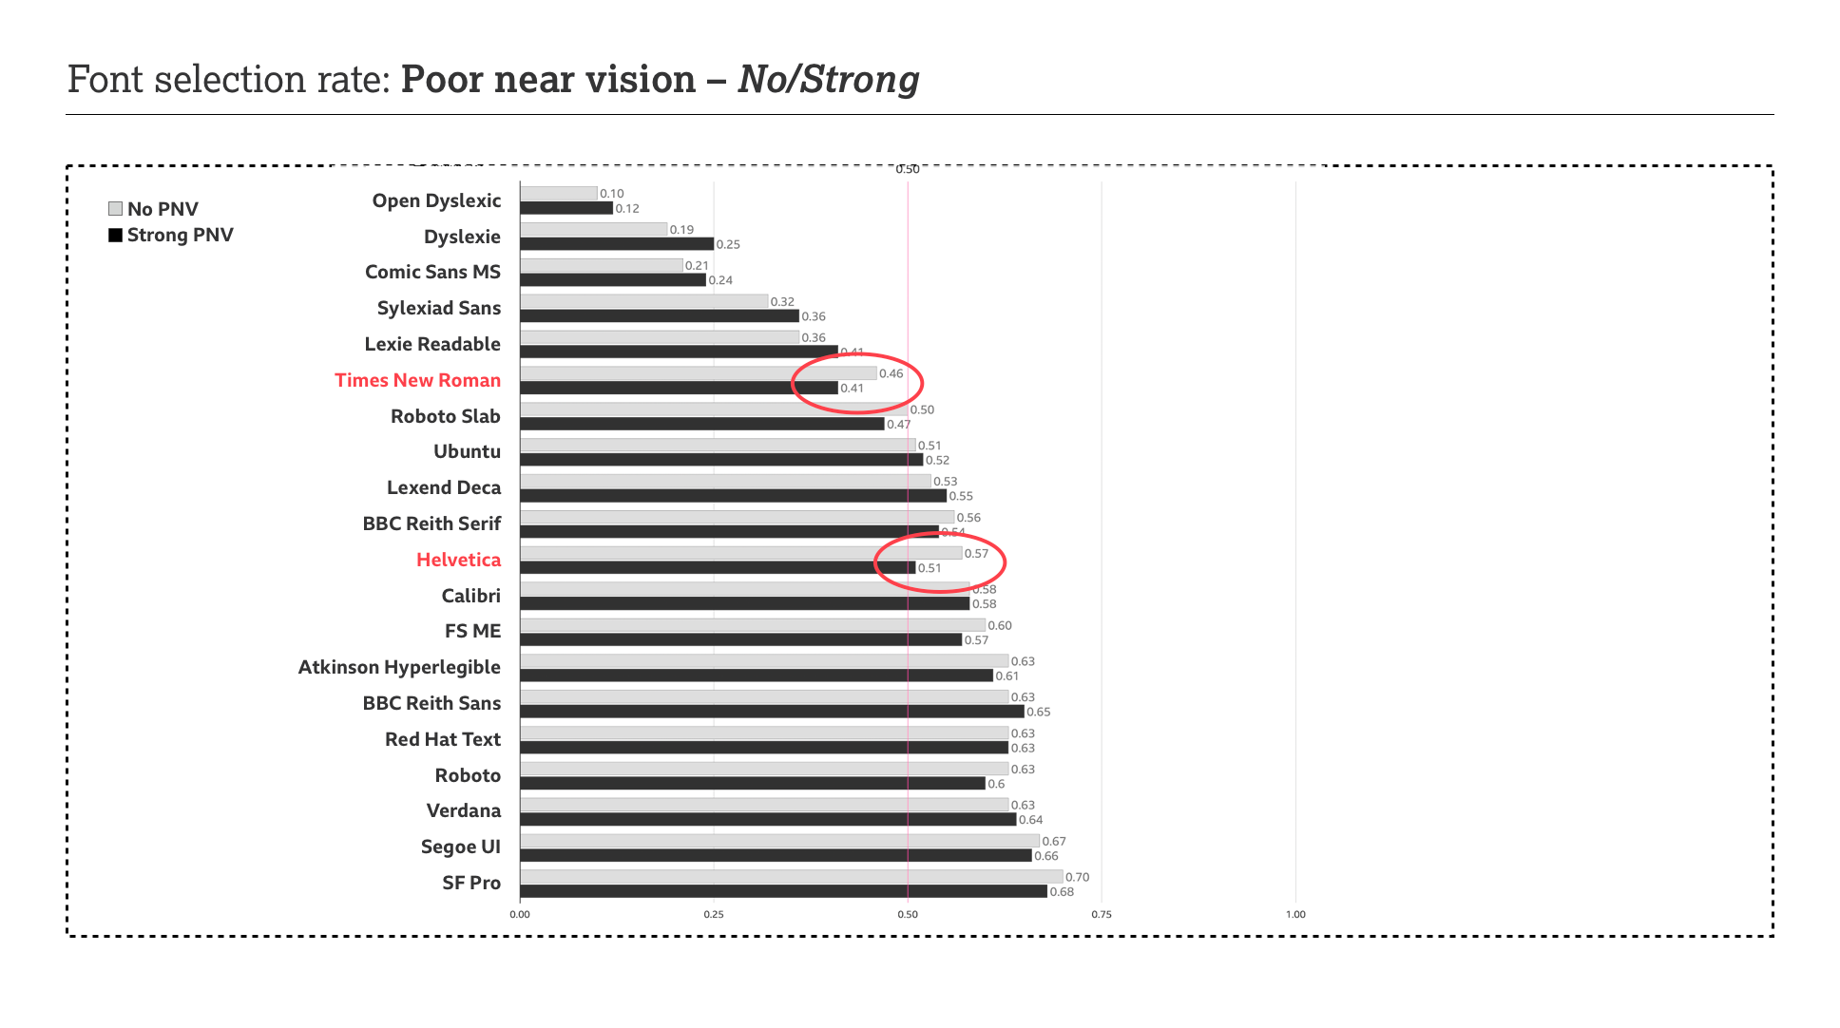
Notes:
GFW:
So to know more we looked at another user group to see if this is a blip.
So we re-ran this with the Strong poor near vision group.
For all 5 fonts these is still a decline but for Helvetica and Times it is still significant
In the next slide we can add the
No poor near vision, mild, moderate and strong groups, and if there is a functional barrier, and the methodology works, we will see a curve.

Slide 24
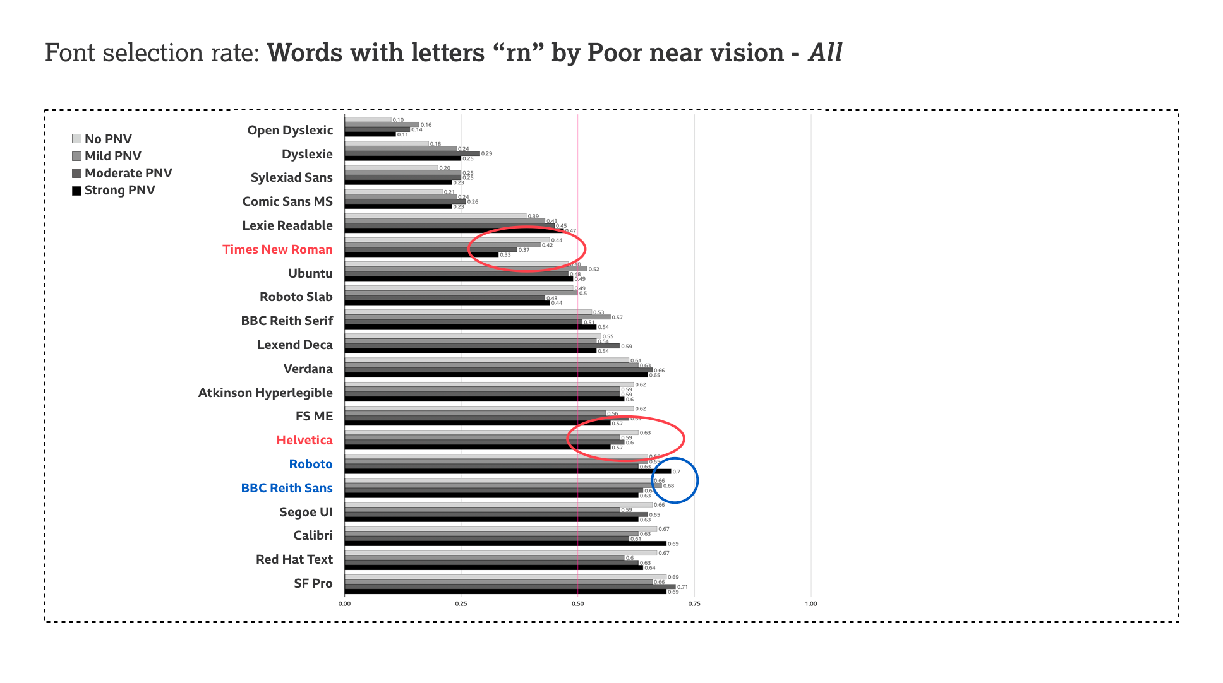
Notes:
GFW:
And there it is.
Helvetica it is less pronounced but for Times it is very clear.
At the same time Roboto has a spike so if there is something wrong with Times, Roboto is doing something right. And because of the richness data we can start looking at the specifics… so the first thing we looked at was one of the problematic letter combinations, “rn” or specific features, or complex combinations.

Slide 25
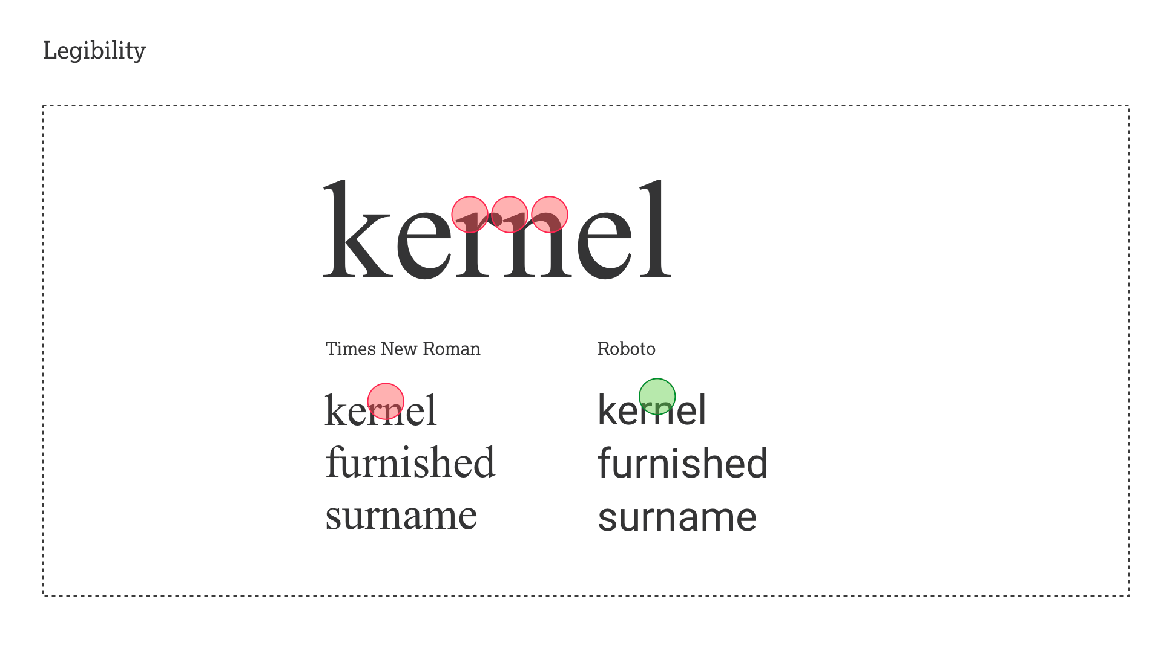
Notes:
GFW:
And there is barrier number 1.
In times rn looks like an “m” so we end up with words that read “kemel”, “fumished” and “sumame”
Roboto viewed alongside times there is a visible gap separating the r and n and therefore the legibility and readability of the word is a lot better.
This will not be the only issue with Times and we need to look at all letter combinations, features and more user groups.
My takeaway is the data the data can help us pinpoint functional barriers

Slide 26
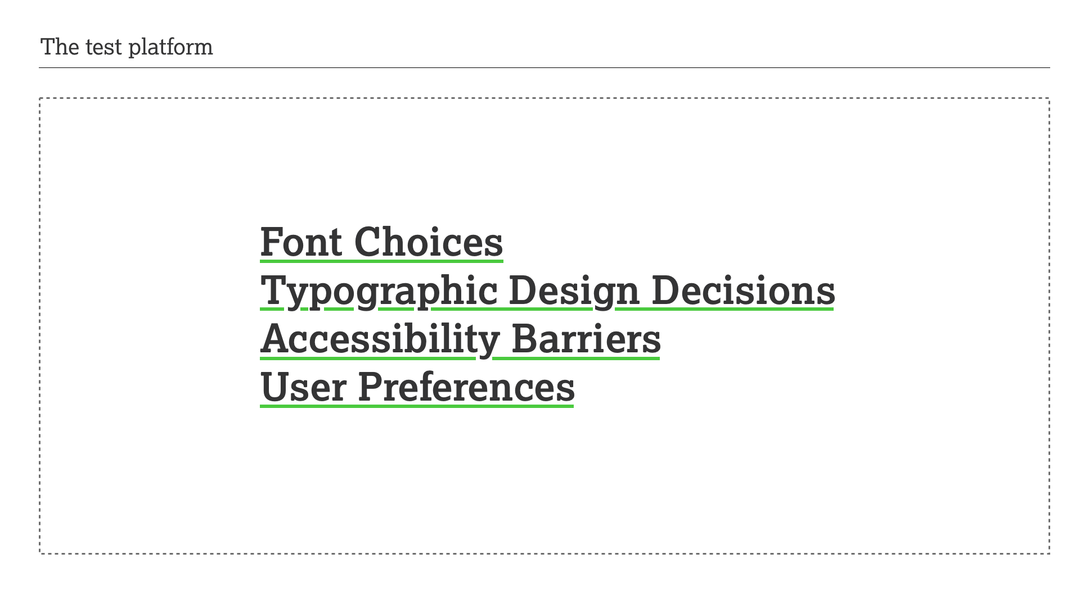
Notes:
GFW:
So where we are is in a confident place that we have a methodology that can help with analysing fonts
The millions of potential data intersections possible, we can dive deeper to find and understand more barriers.
And this is all done because users were given the opportunity to tell us which is the easiest to read and what they prefer.
Thank you

Slide 27
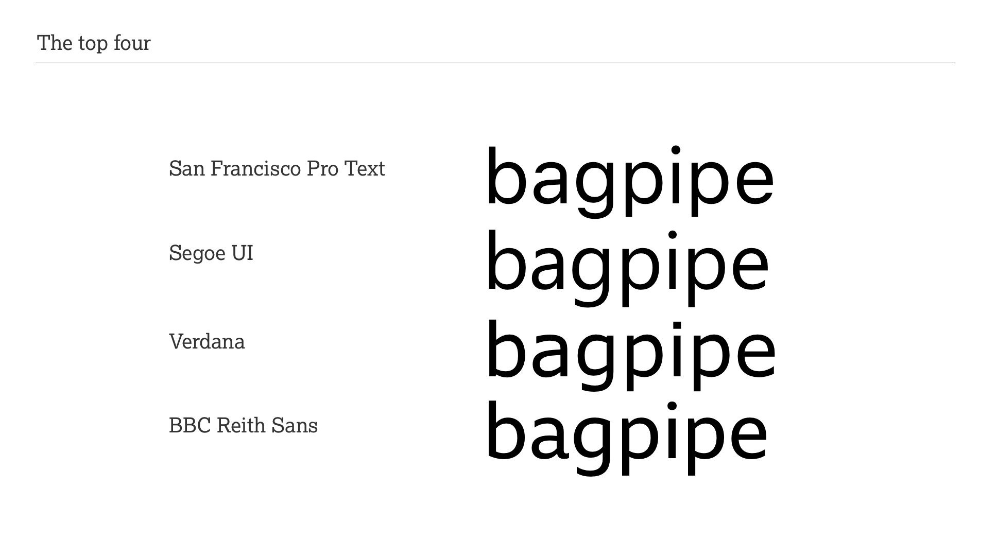
Notes:
BM:
In the beginning David spoke about emotional accessibility, and how we cannot simply choose typefaces because the function better.
Gareth then took us through some survey results and as a typeface designer and typographer I find the results rather revealing and life affirming.
Over the next few slides I would like to go into a bit more detail on type features and muse why some work better than others.

Slide 28
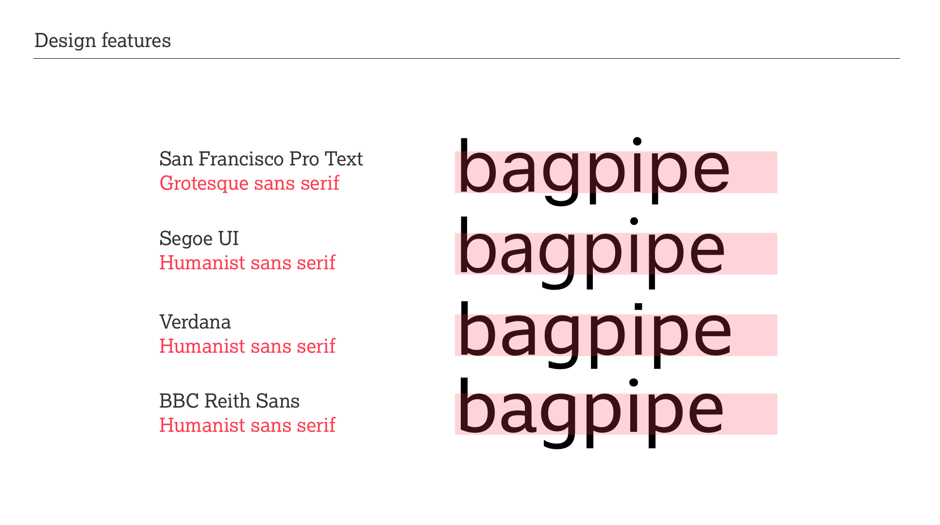
Notes:
BM:
When you look at the survey results you will find that four typefaces are the top four performers: SanFrancisco Pro, Segeo, Verdana and BBC Reith Sans.
For most people the obvious feature is that they are all Sans Serif but we can classify them into two distinct styles: Grotesque and Humanist.
When people were first exposed to sans serif typefaces in the mid-19th century they exclaimed that they looked grotesque because people were only used to seeing serif typefaces of varying styles and fanciness.

Slide 29
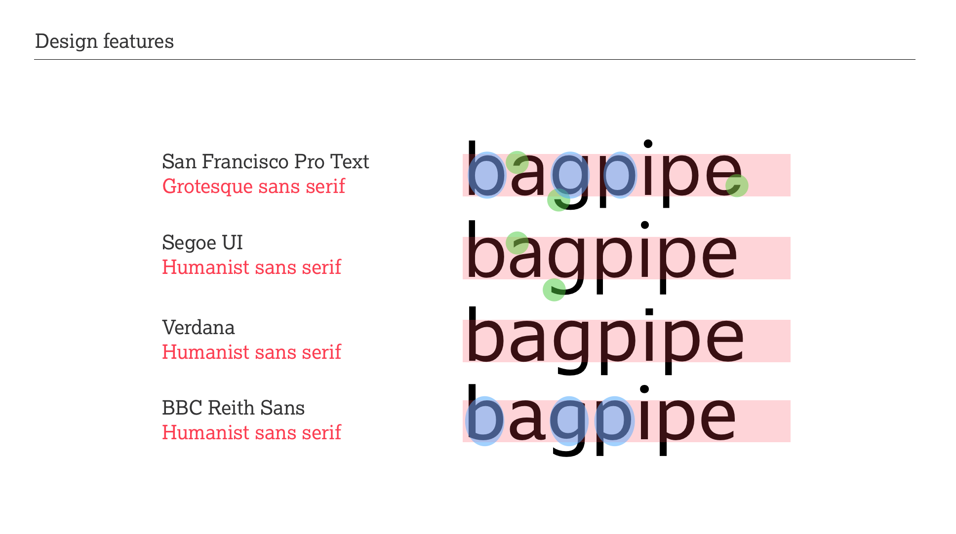
Notes:
BM:
Let’s look at some design features in more detail to understand and recognise these two type styles.
Grotesque types in the main have closed letter shapes such as the a and e where the stroke terminal loops back into the characters, as if drawn drawn by a compass.
Humanist designs in contrast have open character shapes that are more akin to the movement of formal handwriting. This allows for more distinction between similar shapes such as c e and o and thus making them less prone to be mistaken. Grotesque designs tend to have mirror shape b d g p q designs. This can also a feature of some contemporary Humanist design such as Segeo, but normally they are asymmetric, thought to be helping with differentiation.. Humanist designs often have ascenders and descenders, the top and bottoms of b and p, that reach beyond capital heights, lending softness and differentiation.
Grotesque designs tend to have very regularised and even width proportions, as do some contemporary Humanist designs. San Francisco Pro and Segeo are very regularised but Verdana and Reith Sans have variation with a and e a touch wider.

Slide 30
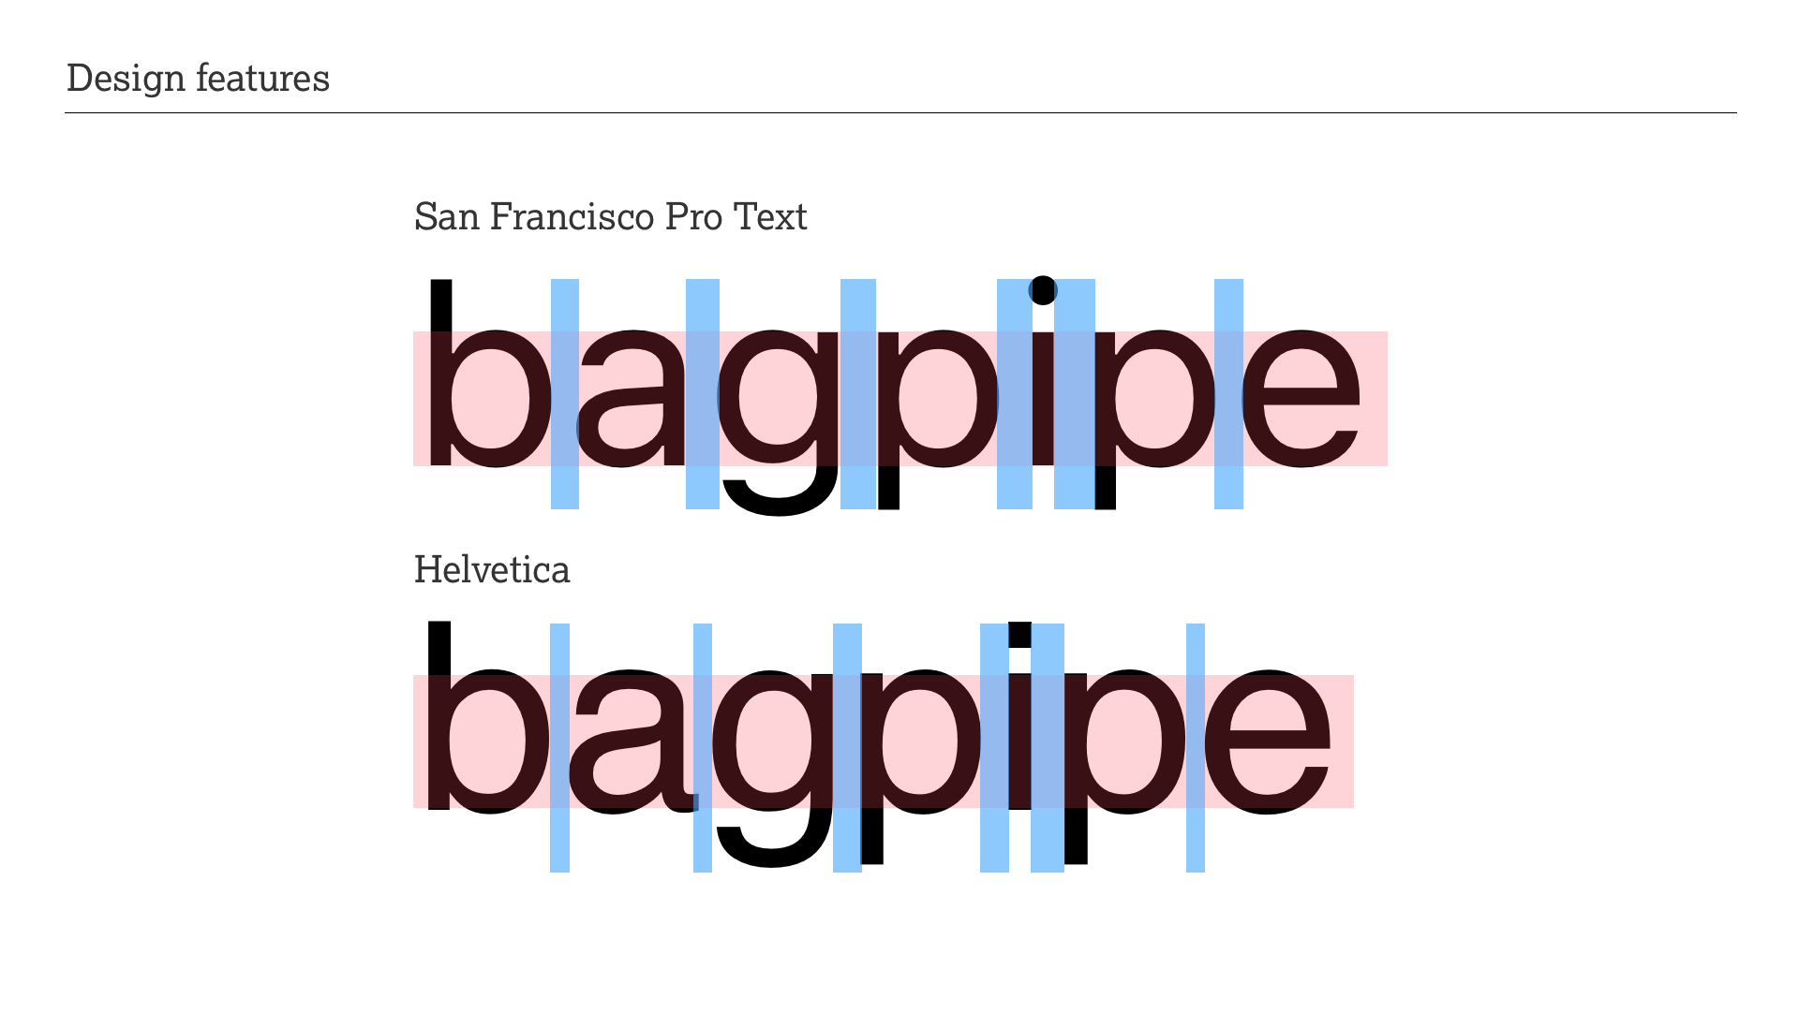
Notes:
BM:
From Gareth’s statistics we have seen that San Francisco tends to perform best across many sections of the survey.
Yet when we look at Helvetica we see that it does not do particularly well even though they are very, very similar and based in the same aesthetic. Why is that? The answer may lie in the rather tight letter spacing of Helvetica that could cause difficulty with discerning individual shapes.

Slide 31
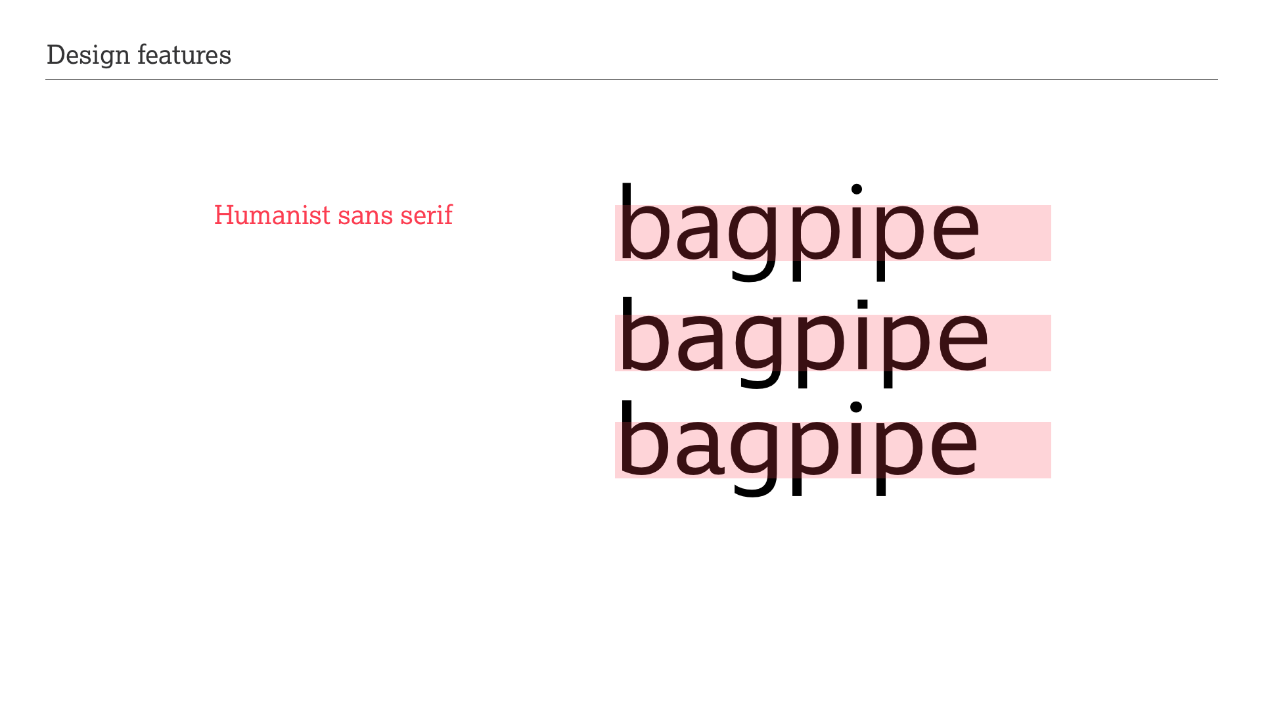
Notes:
BM:
The three humanist designs Segeo, Verdana and BBC Reith Sans perform very well, and within narrow margins of each other. Out of the three Reith Sans is probably the one that has asymmetric mirror shapes characters b d g p q. If this is such an important accessibility feature as often claimed, why does Reith Sans not come out at the top but actually is around fourth place? Is it because it has more personality, more emotional expressiveness, than the rather bland designs of Segeo and Verdana?

Slide 32
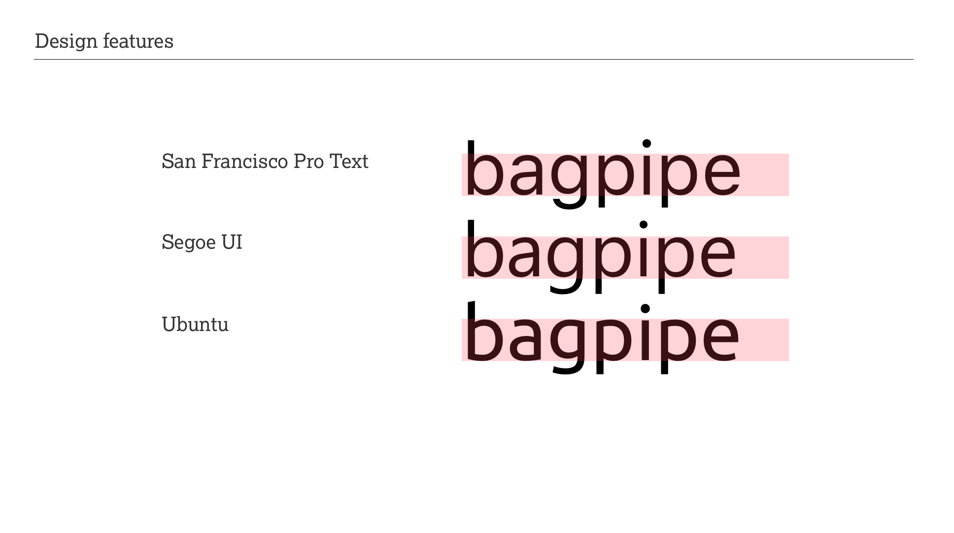
Notes:
BM:
When we look at the Ubuntu statistics we can see that it consistently hovers above the 50% threshold, its performance far below my expectations.
It has all the hallmarks of a successful Humanist designs as discussed before but we can see that its font weight is just a touch stronger than the others. Is that a deciding factor? Is the weight just outside acceptable parameters?
Or is the design too contemporary? Compared to Segoe and San Francisco it is most definitely not boring.

Slide 33
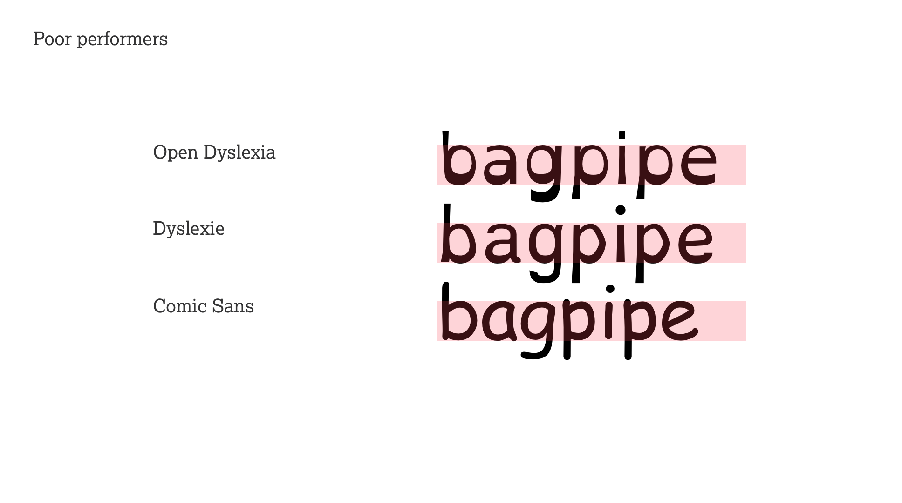
Notes:
BM:
Gareth has already pointed at the poor performance of the so called accessible fonts Open Dyslexia and Dyslexie. These two have all the structural features of the top performing fonts such as tall x-height and generous letter spacing that are common to San Francisco and Segeo.
Is it that the irregularity which claims to be ‘beneficial’ to dyslexic people is far too much, too disturbing affecting not only the smoothness of reading but also is emotionally quite disturbing? I would almost hazard to say that the accessibility claims are just hot air.
The performance of Comic Sans is a surprise as it is the world’s most used font and some claim it is beneficial to learner readers. Although we have not tested with learner readers it does not perform well across all user characteristics indicating that the claims are probably just make belief. Or maybe people upon seeing it in the survey simply have fallen into the ‘I hate Comic Sans’ trap?

Slide 34
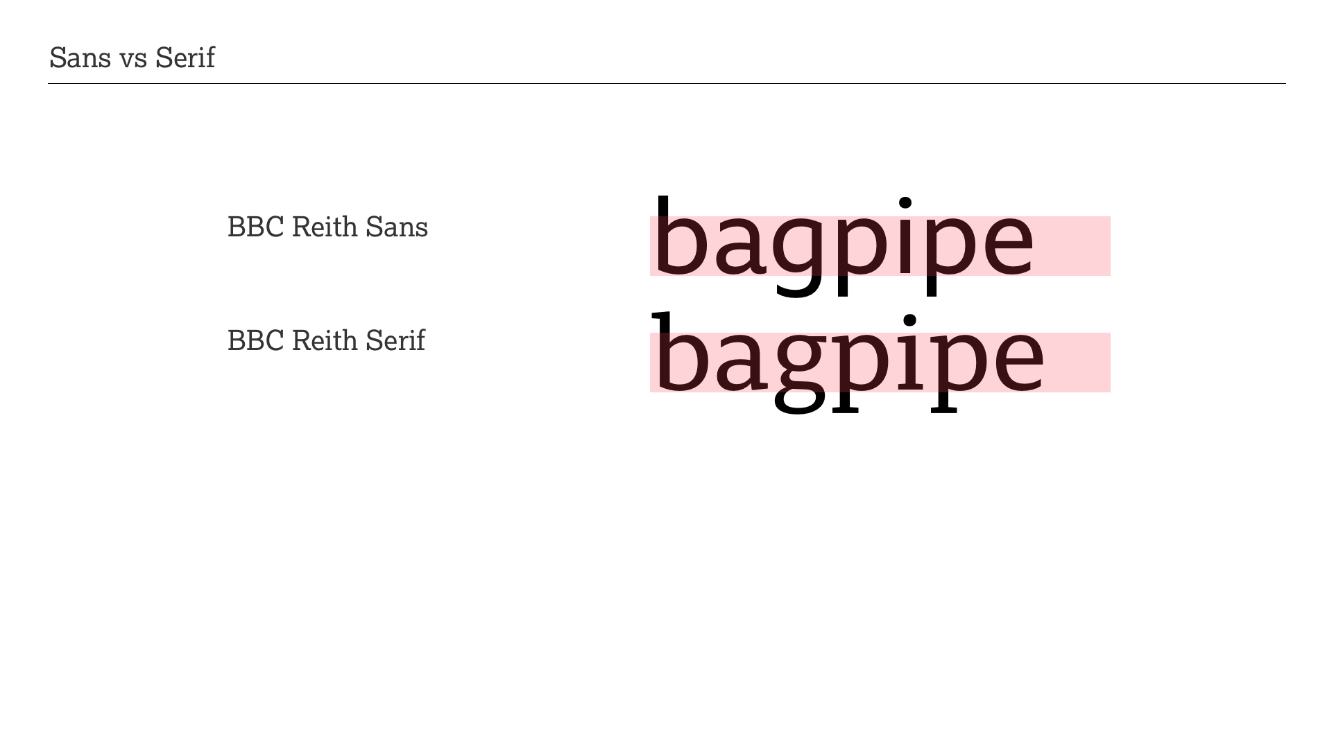
Notes:
BM:
What we have seen is that the top performers are all Sans serif typefaces with the first best serif typeface being BBC Reith Serif doing reasonably well.
As a typographer I find this interesting and wonder if there is an unconscious bias toward sans serif designs.
Is it possible that over the last 30 years, since reading on a computer screen has become more commonplace we associate sans serif with screen and serif with print reading?
I find the results for Serif encouraging because they show that there is no inherent disadvantage to using a Serif typeface in any written output.

Slide 35
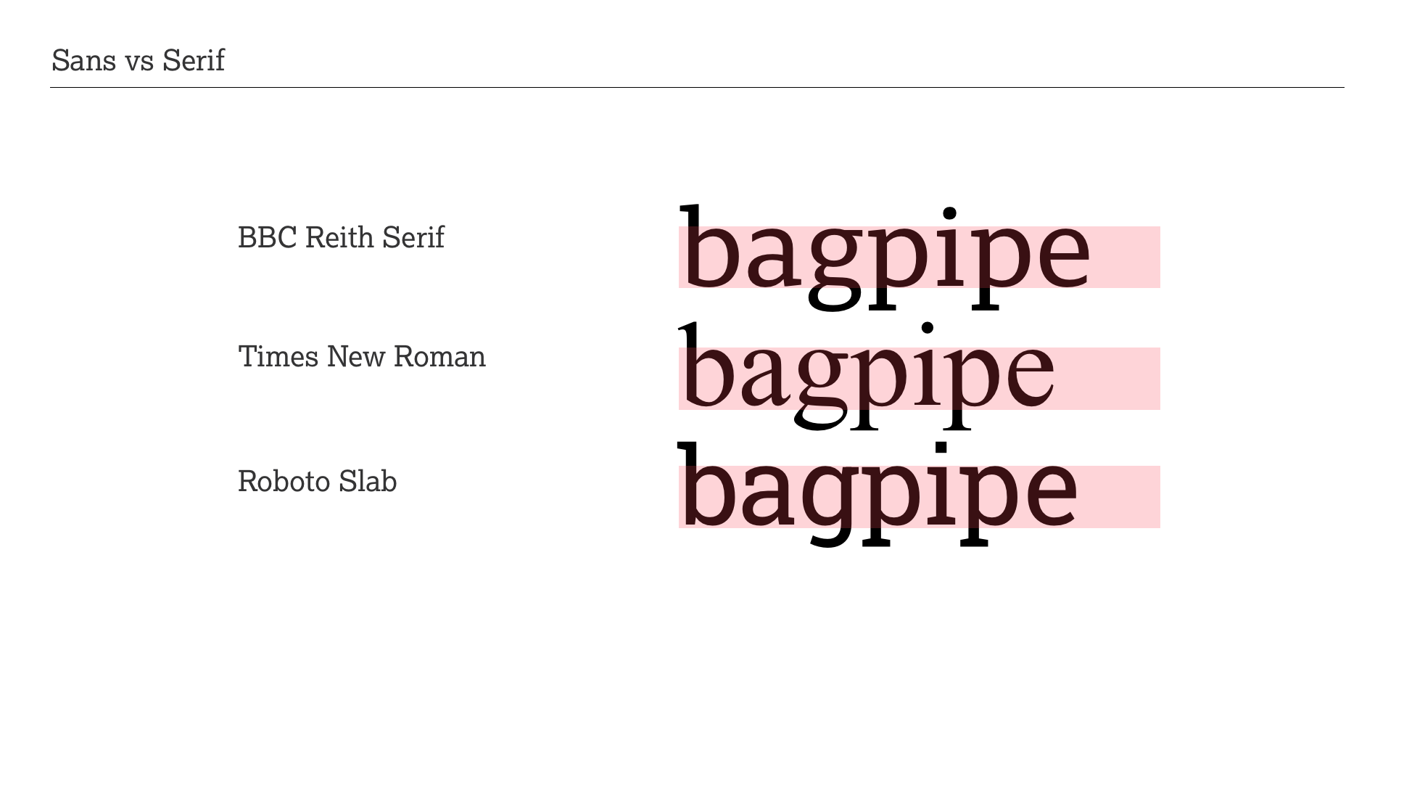
Notes:
BM:
Besides BBC Reith Serif we also included Times New Roman and Roboto Slab in our survey.
Reith Serif is very much based on the design structures of its Sans counter part which we know tend to lead to success. It has only a slight contrast in stroke weights and the serifs are strong but not overbearing.
Strong serifs is also a feature of Roboto Slab and there is barely any stroke contrast. Descenders are kept quite tight compared to the other two designs. A significant design difference is the ‘g’ in Roboto. This type of ‘g’ is supposed to be more accessible. Letter spacing is considerably tighter than Reith Serif.
Times New Roman stands out in this trio. It as a high contrast of strokes and a comparatively low x-height against ascender/descender proportions. It has relatively narrow letter shapes and its letter spacing is tight.
I wonder if it is letter spacing again that accounts for the relatively poor performance of Roboto Slab and Times New Roman. And is it the high contrast of Times, making it look a little dusty affecting emotional accessibility?

Slide 36
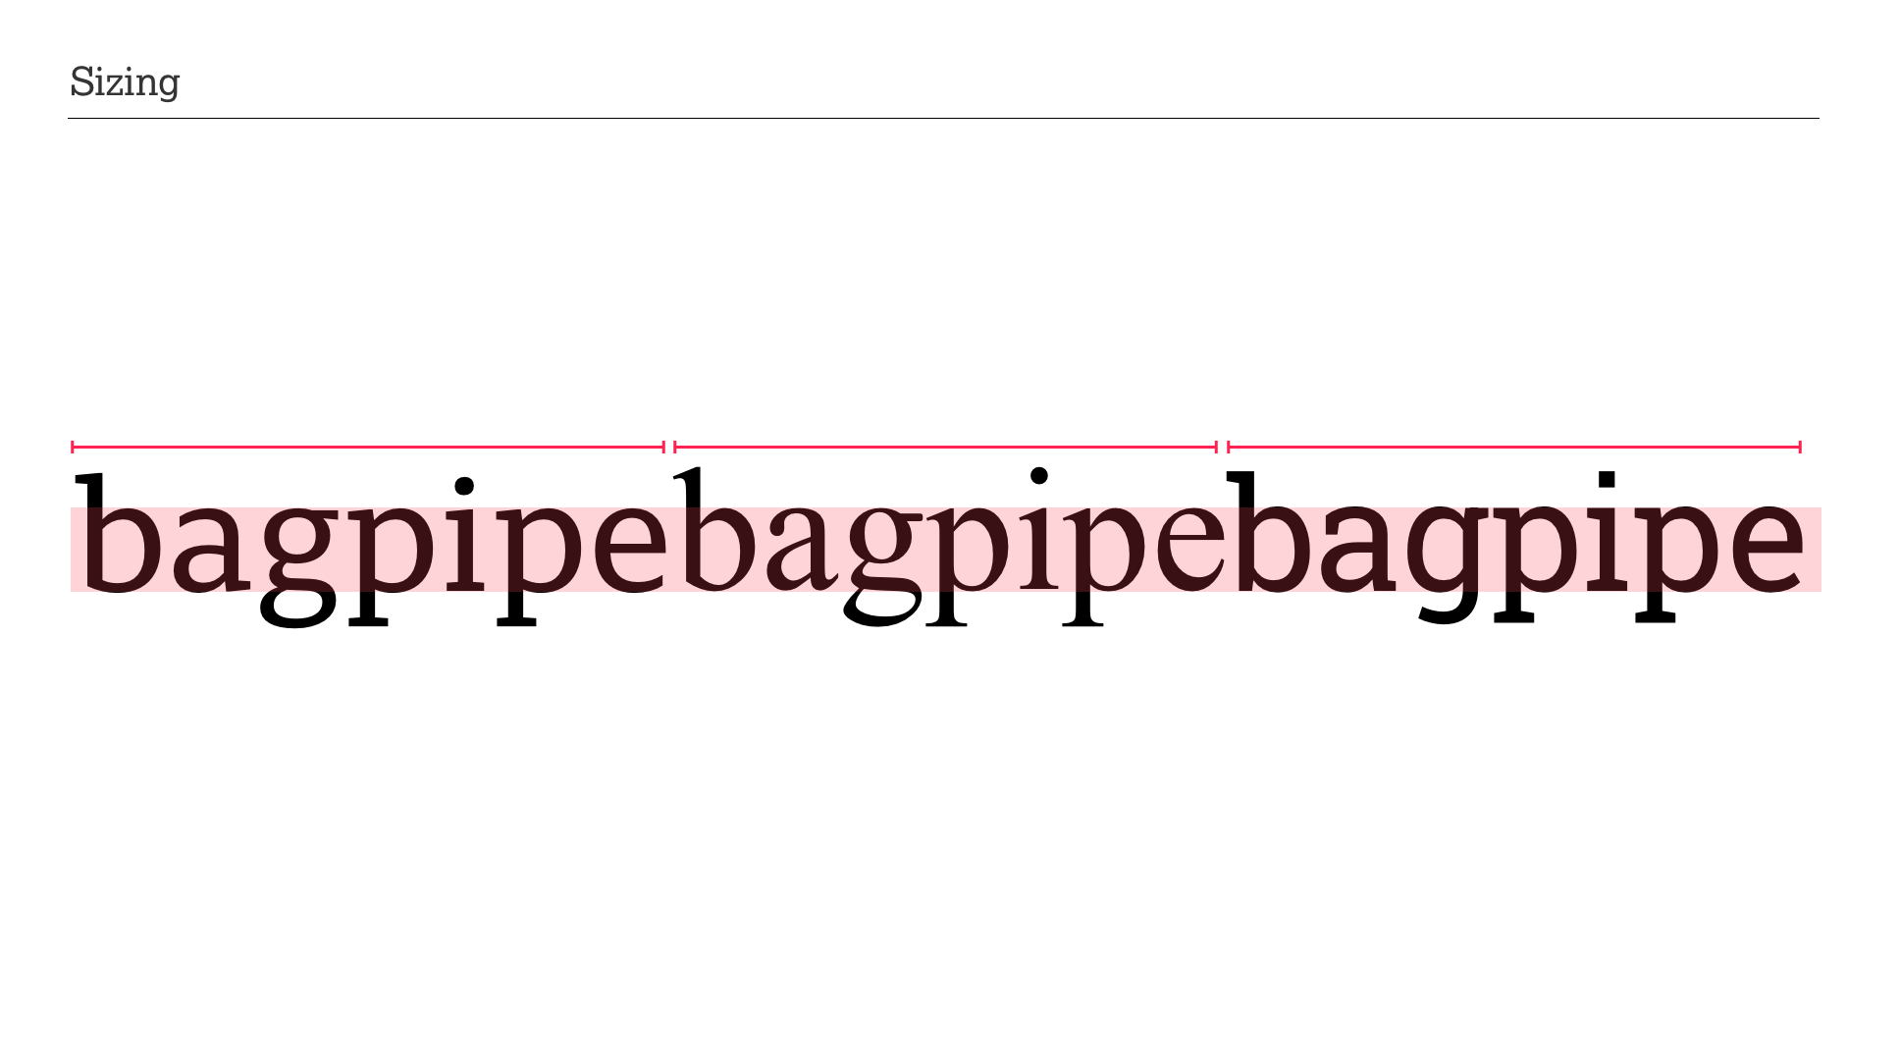
Notes:
BM:
Typefaces, like humans, come in all sorts of sizes and shapes.
In this survey we have selected 20 fonts, some very common, others because of their accessibility claims.
To ensure fair comparison between the typefaces we equalised the x-heights across all fonts showing all the words in the same perceived size. But not all fonts are equal, and this has an impact on accessibility guidelines.

Slide 37
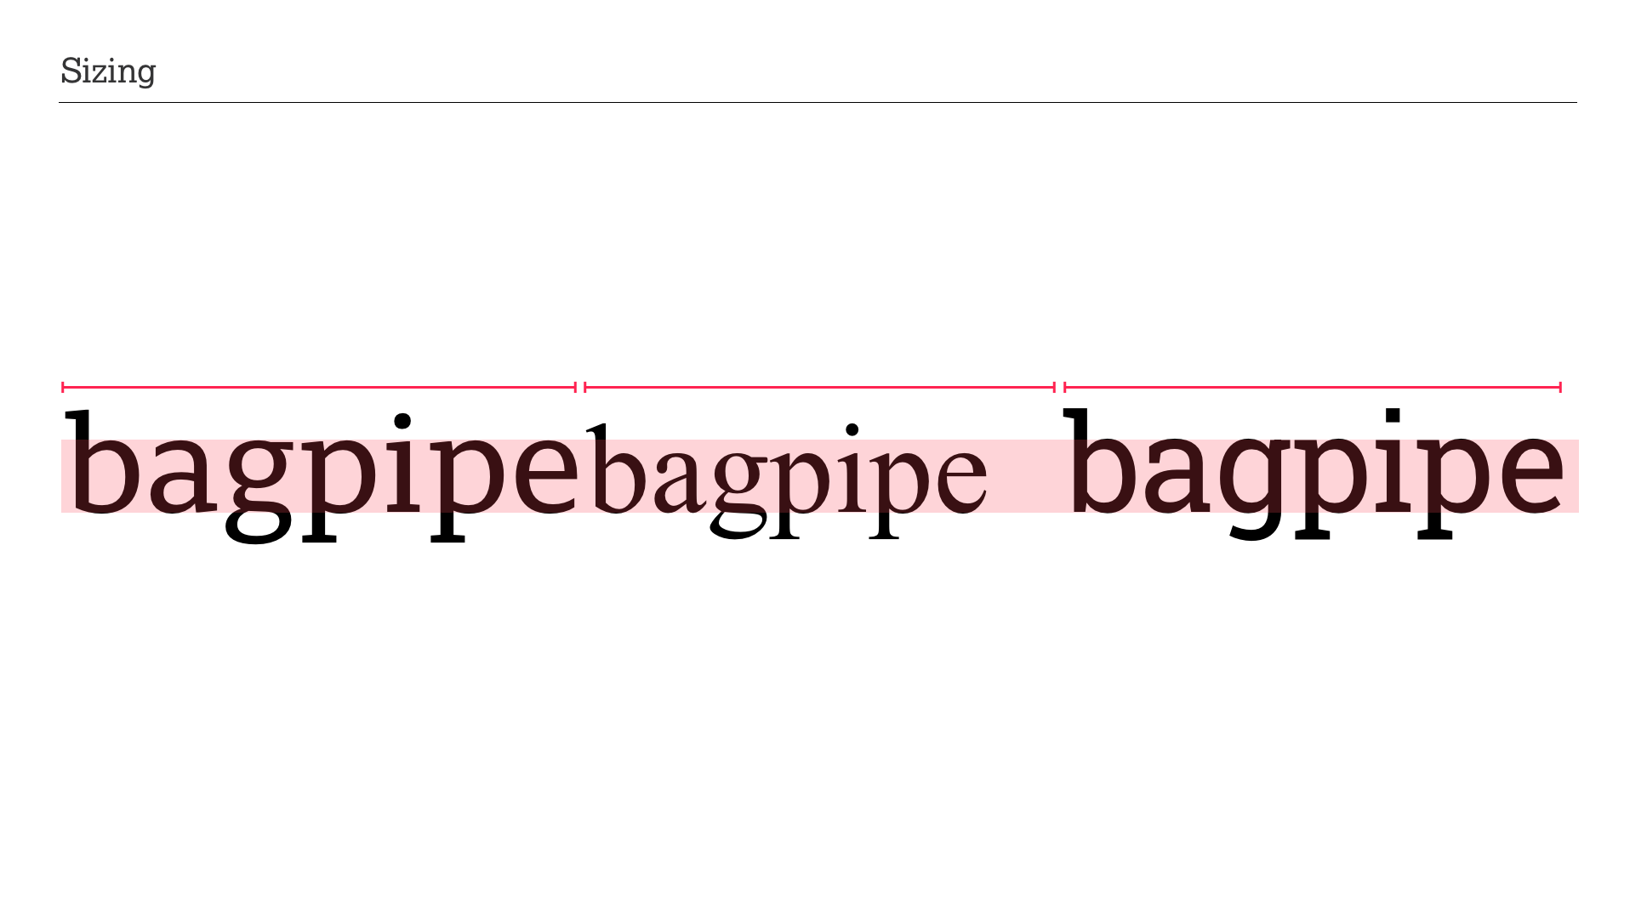
Notes:
BM:
Fonts sizes are usually specified in point or pixels with recommendations calling for a minim size of 24 pixels. Doing so allows the UI/UX designer to tick accessibility software boxes and claim that the work is compliant. But doing so impacts the perceived size as we can see here with Times New Roman that is considerably smaller when specified with the same font size, causing a complete accessibility fail.
Fonts have different height sizings for legacy and stylistic reasons. Although we no longer use metal type where there was a physical boundary for heights, in digital type we also have to account for stylistic requirements for varying height proportions, affecting not only typesetting but potentially accessibility.

Slide 38
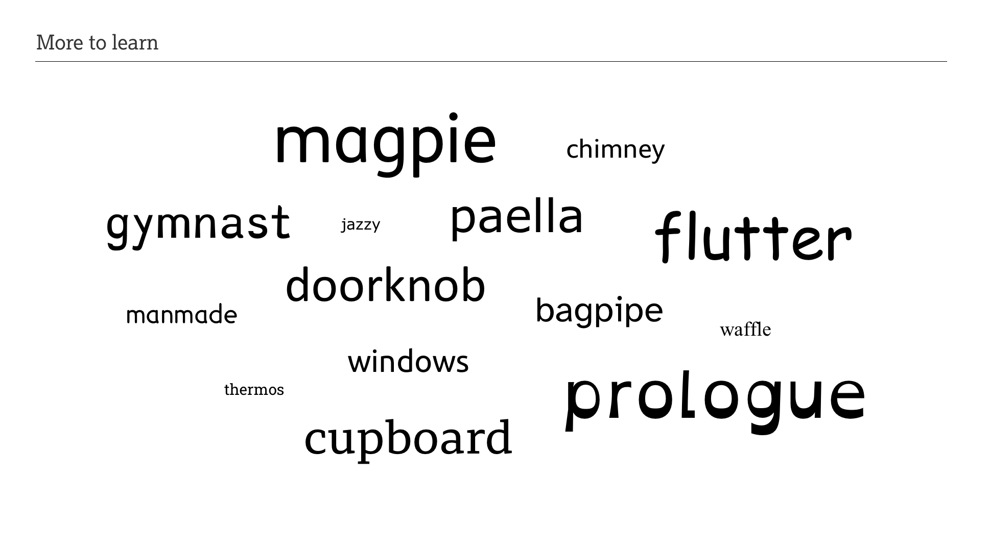
Notes:
DB:
In this presentation we’ve tried to illustrate how important it is to have a holistic view when choosing and applying typefaces.
Whilst our survey skewed toward functional accessibility, there are examples show how important the emotional aspects are.
This survey does not give answers; instead it raises many questions that require further investigation and research.
We do have one answer, though — one size does not fit all.
GFW:
The Readability Group came together as even though we have decades of experience between us we were all interested in knowing more, and now we have a research platform and methodology to look deeper into barriers, challenge claims and inform choice, and back it all up with data.
This platform is re-usable and we intend to do more studies and find other interested parties to open-up the investigation and discussion with.
I hope that you will agree that access to written information is a fundamental human right and it is our responsibility as designers, product owners, accessibility specialists and content developers to protect that right. For those like me who have conditions that impact our ability to access the written word, I am hoping we can finally see more informed choices being made across the industry.
.

Slide 39
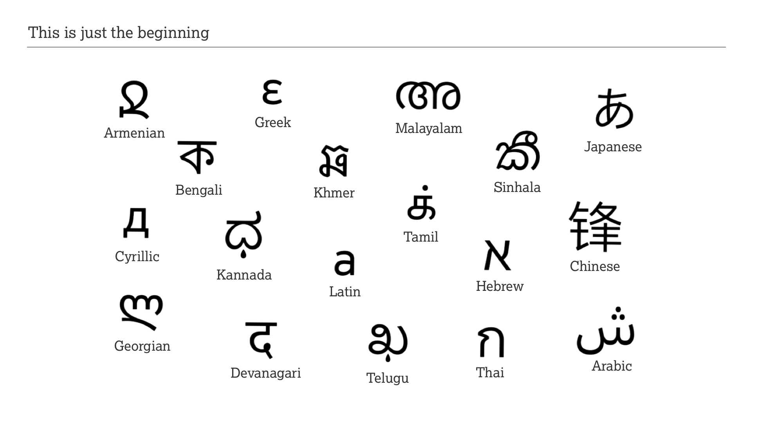
Notes:
BM:
With this survey we have barely scratched the surface of typographic accessibility but with our combined experience in branding, typography and accessibility we can make sense of these initial findings, and most importantly, we can ask the right questions. We started the survey with Latin characters but more than 6 Billion people on this planet natively use letters from in well excess of 40 writing systems, some used by many, some used by a handful of people.
— Like humans, type comes in all sizes and shapes.

Slide 40
